Slide 1
Introduction
Network Management
Bahador Bakhshi
CE & IT Department, Amirkabir University of Technology
This presentation is based on the slides listed in references.

Slide 2
Outline
What is Network Management?
Why Network Management?
Who is Who in Network Management?
What is going in Real Network Management Systems?
Why is Network Management Challenging?
Network Management Evolution

Slide 3
Outline
What is Network Management?
Why Network Management?
Who is Who in Network Management?
What is going in Real Network Management Systems?
Why is Network Management Challenging?
Network Management Evolution

Slide 4
Today’s Networks
Local, Long-distance, Oversea Phone service
IN service, cellular
World-Wide Web
Email, DNS, FTP
News, Telnet, IRC
RealAudio, RealVideo
MBone
FDDI
ATM
SDH
Access
Networks
Token
Ring
PCS
Fast
Ethernet
WANs
SS#7
PSDN
PSTN
Gigabit
Ethernet
Ethernet
B-ISDN
IN/AIN
ISDN
Computer Networks
Telecom Networks
Video Conferencing
Electronic Commerce
Internet Phone
Banking, Accounting
Distance Learning
Video-on-Demand
Tele-conferencing
Video-conferencing
Internet Telephony

Slide 5
What is Network Management?
Computer networks are complex live systems
  Require a great deal of attention to be kept up & running
    E.g. Failures, Performance tuning, Service Provisioning, accounting, …
Network management system:
  Anything that has to do with running a network
    Technologies
    Tools
    Activities
    Procedures
    People

Slide 6
Running a Network: OAM&P
Operations
  Keep the network running smoothly, monitor for alarms, watch for intrusions and attacks, ...
Administration
  Keep track what’s in the network, who uses what, housekeeping
Maintenance
  Repairs failures and upgrades network
Provisioning
  Configure the network to provide services, turn up services for end customers

Slide 7
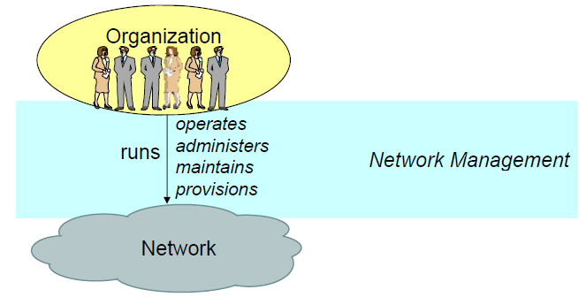
What is Network Management
Therefore, network management is the activities, methods, procedures, and tools that pertain to the operation, administration, maintenance, and provisioning of networks

Slide 8
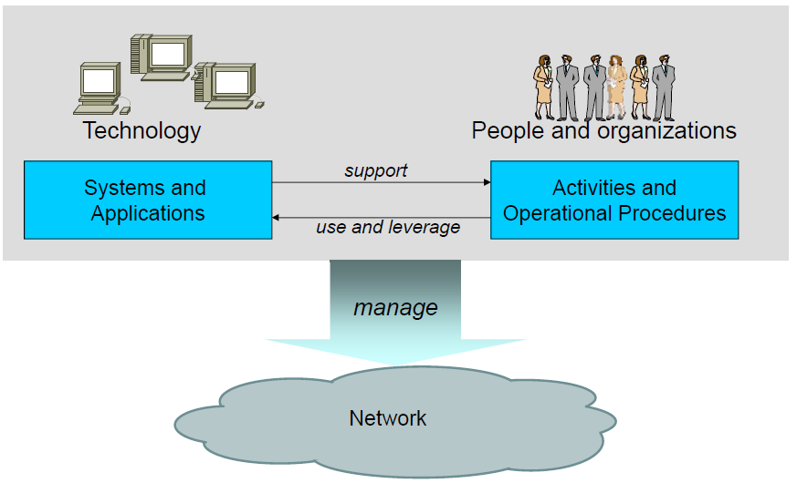
Network Management System

Slide 9
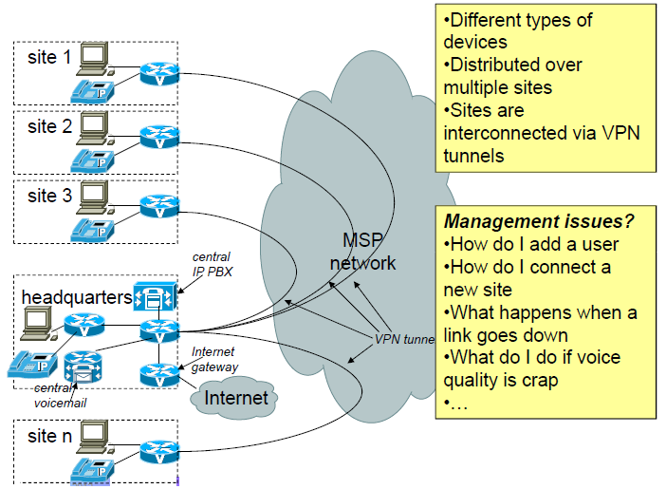
Network Management Examples (1)
Medium-sized business network

Slide 10
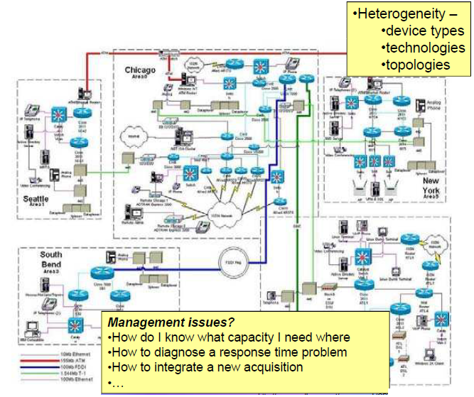
Network Management Examples (2)
Enterprise Network

Slide 11
Other Perspectives
The NM operations & procedures & functionalities can be classified from other perspectives than (traditional) OAM&P
Classification based functionalities
  ISO’s point of view: FCAPS
Classification based on layers
  ITU-T’s point of view: TMN
Classification based on business model
  TMF’s point of view: eTOM
Other classifications …

Slide 12
FCAPS
Fault management
  Detecting, isolating, and elimination of failures
Configuration management
  Setting management parameters, backup and track changing (hardware & software) configurations
Accounting management
  Resource usage monitoring
Performance management
  Resource utilization monitoring and management
Security management
  Security policies definitions, implementations, monitoring

Slide 13
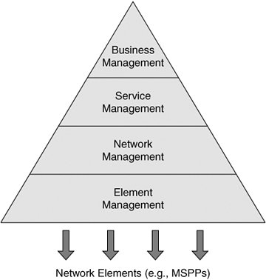
TMN

Slide 14
eTOM
Customer
Strategy, Infrastructure
& Product
Operations
Strategy &
Infrastructure
Product
Operations
Fulfillment
Assurance
Billing
Commit
Lifecycle
Lifecycle
Support &
Management
Management
Readiness
Enterprise Management
14

Slide 15
Outline
What is Network Management?
Why Network Management?
Who is Who in Network Management?
What is going in Real Network Management Systems?
Why is Network Management Challenging?
Network Management Evolution

Slide 16
Why Network Management?
Computer/Teleco networking is a business
  Networks are built to make money
Income (revenue) vs. TOC (Total Ownership Cost)
Income
  Service provision for customers with desired QoS
TOC
  Cost to build up the network and its operation cost

Slide 17
Why Network Management? (cont’d)
Cost (to provide the services)
  NM to maximize efficiency, thus minimizing cost
Revenue (realized through the services)
  NM to ensure services are accounted for and delivered when and where they are needed
Quality (of the delivered services)
  NM to maximize the inherent “value” of the managed network and services provided
Notes:
These factors affect the business of service provider. Cost and revenue directly affect and the quality parameter indirectly influence the success of business of the service provider.

Slide 18
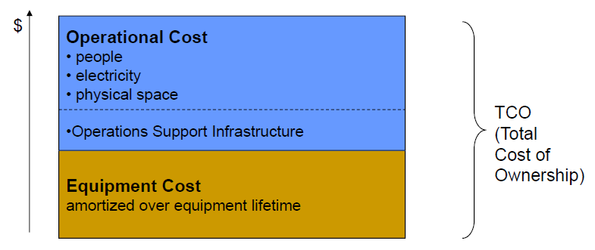
Why NM: Cost
CAPEX (Capital Expenses): Equipments, Software, License, Location, …
OPEX (Operation Expenses) : People, electricity, maintenance, …

Slide 19
Why NM: Cost (cont’d)
Important fact
While network equipment and NM software are expensive, but the cost is amortized over the lifetime of the network; hence, OPEX >> CAPEX
Attempt to decrease OPEX
  Even if it results in increasing in CAPEX
Efficient network management system can decrease OPEX significantly, e.g., …

Slide 20
Why NM: Cost (cont’d)
More efficient troubleshooting and diagnostics
  Free up operators from routine problems to focus on the hard stuff
  Reduce amount of expertise required
Automation of service provisioning, workflows
  Less operator involvement
  Increased throughput
  Less prone to operator error
    >50% of network & service outages! (impacts cost and quality)
Planning, bottleneck analysis
  Deploy resources where they are needed most
  Optimization of topologies
  Minimize investment needed for given network goals
And more

Slide 21
Why NM: Revenue
Flexible billing and accounting systems
  Combine multiple services
Automated provisioning systems
  Services on demand – “instant on”
Customer views of services delivered
  Stats on calls made, bandwidth consumed, service levels
Time until revenue
  Minimize time to service from time service is ordered
And more

Slide 22
Why NM: Quality
Central term in networking: QoS
  QoS = managed unfairness (to satisfy service level objectives)
    In management, QoS is also referred to as “service level”
  Examples of quality
    Availability of service, Service response time, Delay, jitter, echo, clipping, Video quality, …
While network must be designed for QoS requirements, network operation management is also greatly influence QoS

Slide 23
Why NM: Quality (cont’d)
Automated provisioning
  More efficient provisioning (less order-to-service time)
  Avoid misconfiguration through end-to-end provisioning
Provision network for certain quality
  Proper dimensioning, Tested service configurations, Policies for traffic shaping, connection admission control
Help identify, diagnose, fix problems (reactive)
  Alarm correlation, faster problem is resolved, minimizing the time of outages, try not to wait until customer complains

Slide 24
Outline
What is Network Management?
Why Network Management?
Who is Who in Network Management?
What is going in Real Network Management Systems?
Why is Network Management Challenging?
Network Management Evolution

Slide 25
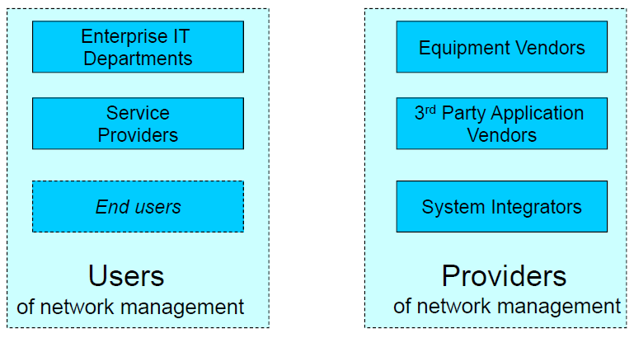
Network Management: The Players
Notes:
Network management is a big industry with many partnerships

Slide 26
Service Provider Interest in NM
Service providers sell communication services
  Many market segments: Long Distance versus Local Exchange Carriers, voice, data, video, …
Whereas differentiation in services
  All running networks is their core business
  However, many companies offering same services
    Compare airlines: same air planes, airports, “function”
Major differentiation: Quality (SLA)

Slide 27
Service Provider Interest in NM (cont’d)
Management-related differentiation
  Turning up new services the fastest
  Running the network at lowest cost
  Fixing problems the most efficiently, or avoid them altogether
  Ability to give service level guarantees, and keep them
  Best customer service
  Who squeezes the most out of network investment

Slide 28
Enterprise Interest in NM
Enterprise networks are different from service provider networks:
Running networks is not the core business
  Communication services for enterprise operation
  IT departments are cost centers
The network has only one customer & the customer has not any alternative options
  The network is not the primary competitive differentiator

Slide 29
Enterprise Interest in NM (cont’d)
    Since the network is cost, efficient management → minimizing operation costs. E.g.,
    Ability to tie in suppliers, partners, customers
    Ability to quickly integrate a new acquisition
    Imagine one hour outage…
      at a financial brokerage, at a car manufacturer, …
Since network management does not directly determine revenue of enterprise → less investment on NM systems
It’s not just the network, it’s also Data Centers, applications, and systems

Slide 30
End Users
Customers of communication services
Not interested in management unless part of the service (“self service”)
  Customer care system
  Trouble ticketing system
  Service on demand
  One bill
  Service statistics online
  Set up usage policies for kids

Slide 31
End Users
Network managers
  Many roles, for example
    Network administrators
    Craft Technicians
    Device administrators
    Help desk operators
    Network planners
Network management systems, software, interfaces to support and help them be effective

Slide 32
Equipment Vendors Interest in NM
Make a business out of selling networking and data center equipment
  Not management systems (application software)
Manageability: Ease with which a vendor’s equipment can be managed
  Support by standard management tools
  Time & effort to integrated with custom operations support infrastructure
  Availability of expertise, qualified personnel
  Required training cost, dependency on support contracts
  Proneness to operational errors

Slide 33
Equipment Vendors Interest in NM
Shift in perception
  Past: network management a necessary evil
  Present: network management competitive differentiator
Relevance to the equipment vendor
  Lower cost of network ownership
  Build brand value: other products work similar to ones already deployed

Slide 34
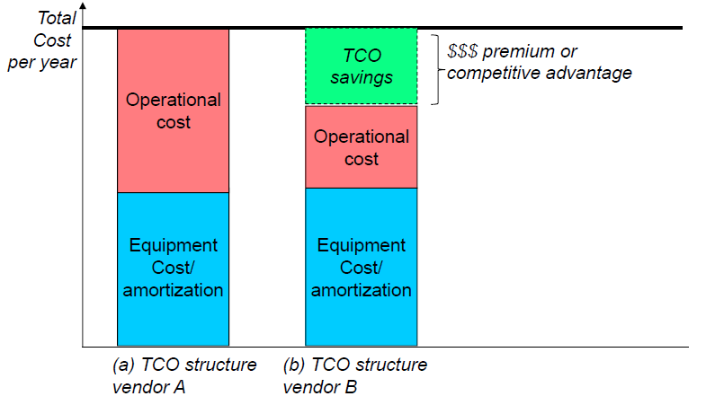
Equipment Vendors Interest in NM
If vendor B’s equipment is less costly to manage than vendor A’s…

Slide 35
NM Application Vendors
Make a business out of developing, selling, servicing network management applications
  Fill the gaps that equipment vendors leave open
    Multi-vendor support
    Complete end-to-end NM instead of device management
    Management functionalities instead of managing devices, e.g., work flow, customer care, …
Competitive features
  Multi-vendor support
  Customizable
  High-end management functionalities
  Easy to use and integrate

Slide 36
System Integrators
Make a business out of network management
  How when NM Application providers develop the tools
  Because of, in real world
  No one tool or application can do every management tasks
  → Multiple applications for different purposes
These applications manage the same network (from different aspects); hence, should be integrated, because
  Work on the same databases
  Used in the same workflow procedure
While there are many management standard protocols and interfaces, in real world
  Applications don’t work together as easy as it seems
  NM users need more integrated functionalities

Slide 37
System Integrators
Fill the niche between COTS (Commercial of-the-shelf) and custom development by network providers
  Specific operations support infrastructure
    Management applications to integrate
    Operational context to integrate: enterprise information systems, ordering, b2b, …
  Develop software wrappers, protocol converter/gateways, API customization, …
Make a business out of management requirements that are specific only to particular management users

Slide 38
Put Altogether

Slide 39
Put Altogether

Slide 40
Outline
What is Network Management?
Why Network Management?
Who is Who in Network Management?
What is going in Real Network Management Systems?
Why is Network Management Challenging?
Network Management Evolution

Slide 41
A Day in the Life of a Network Manager
type of organization that runs the network
particular function that the network manager plays within the organization

Slide 42
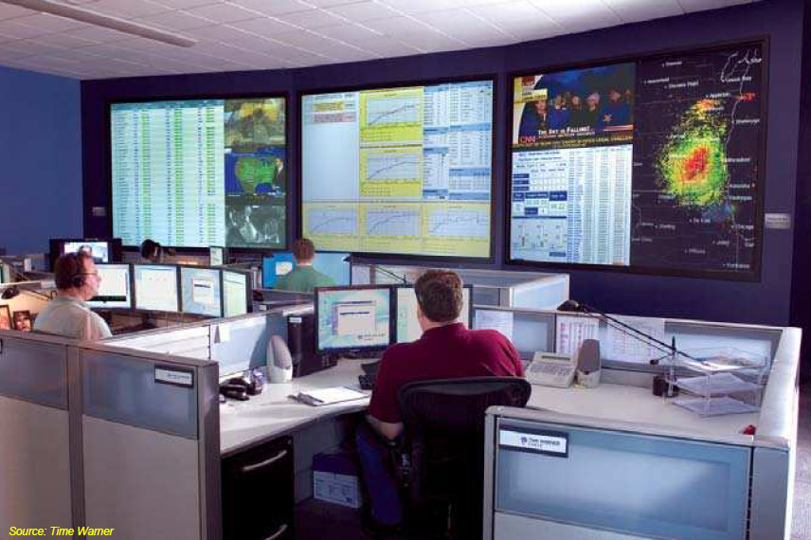
A Network Operator for a Global Service Provider
A typical NOC(Network Operation Center)

Slide 43

Network Management Tools
Management tools: management systems that network managers interact with

Slide 44
Network Management Tools
User interface of the tools
  Flow through systems may not have user interface at all
    Provisioning tasks are done automatically, user never touches it
  Text-based interfaces often preferred by power users
    More productive, know what they are doing, don’t be slowed down by mouse clicks and navigation
  GUIs
    Occasional users, Training, …
    “Legitimate” GUI uses: Monitoring, Visualization of large quantities of data, Summary reports

Slide 45
NM Tools Examples : Network Analyzers
Network analyzers come under many different names, including packet sniffers, packet analyzers, and traffic analyzers
view and analyze current traffic on a network
capture or “sniff” packets that flow over a port of a network device and present them in a human-readable format

Slide 46
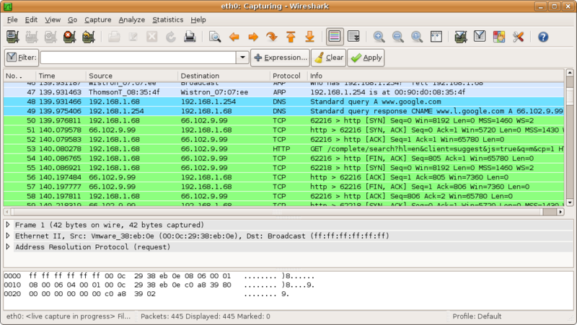
Network Analyzer: Wireshark

Slide 47
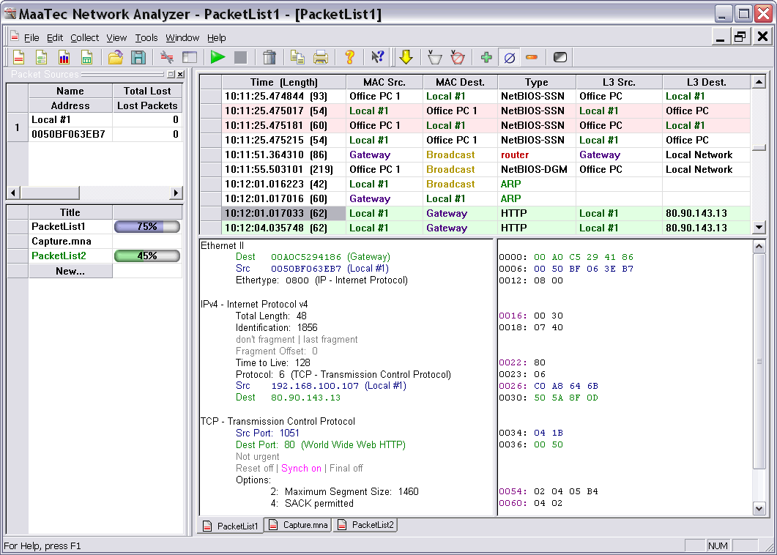
NM Tools Examples:Network Analyzer -MaaTec

Slide 48
NM Tools Examples: Device managers
View and manage individual devices one at a time
  View statistics
  View alarms
  View configuration
  Change & tune parameters
Most basic interface: Telnet sessions, CLI
  Can do anything on a per-device level
  Often interface of choice for network administrators
GUI, Web app more user friendly (easier to operate, but sometimes less productive for “power users”)
Often specific to a particular vendor and device type

Slide 49
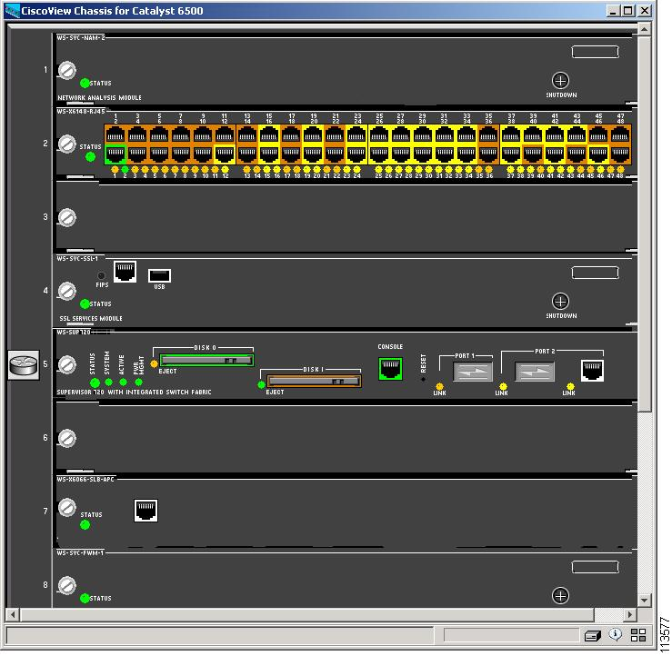
Device Manager – CiscoView

Slide 50
NM Tools Examples :Element Managers
Element managers are systems that are used to manage equipment in a network
designed for equipment of a specific type and of a particular vendor
View device status and configuration and modify their parameter
  e.g. database with network elements
it enables users to back up and archive how devices are configured, to restore device configurations if that ever is required, and to manage the distribution of software images to the devices
element managers can receive event messages from the devices, which enables users to monitor the various pieces of equipment across the entire network, not just one device at a time.
Automatically discover equipment
Northbound Interface

Slide 51
NM Tools Examples : Management Platforms
Management platforms are general-purpose management applications that are used to manage networks
management platforms are vendor independent
  different environments
the primary task is to monitor the network

Slide 52
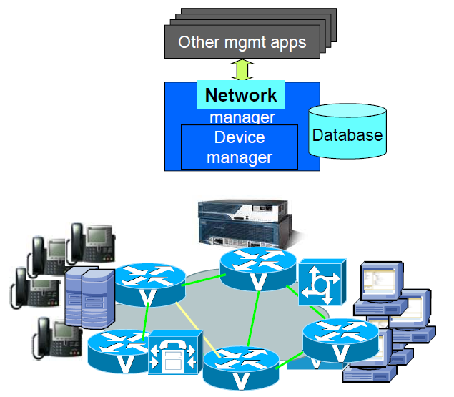
Device/Element/Network Managers

Slide 53
NM Tools Examples : Collectors and Probes
Collectors
  Collect raw data from the network
    traffic statistics
    periodic status snapshots
    events
  Filing, archiving, compression
  Format normalization
  Sometimes, data pre-aggregation, filtering, searching
Probes
  Generation of data from the network
  Measurements: e.g. current service levels
  Offload management applications from high-volume routine tasks

Slide 54
NM Tools Examples : Intrusion Detection Systems
detect suspicious communication patterns on the network that might be indicative of an ongoing attack
Attacks
  attempted break-ins into routers or, servers,
  denial-of-service (DoS) attacks
IDS techniques
  analyzing traffic
  listening to alarms
  inspecting activity logs
  observing load patterns

Slide 55
NM Tools Examples: Performance Analysis Systems
Collect performance statistics
Monitor performance tends
Detect performance bottlenecks
Uses for
  Service level management
    Monitor if agreed-to service levels are being kept Examples: Delay, jitter, voice quality, …
  Proactive fault management
    Detect problems that are brewing
    E.g. deteriorating response times
  Troubleshooting and diagnostics
  Network planning

Slide 56
NM Tools Examples: Alarm Management Systems
collecting and monitoring alarms
Correlate alarms
  initial diagnoses for the root cause of an alarm
  provide impact analysis to forecast the fallout that an alarm might have

Slide 57
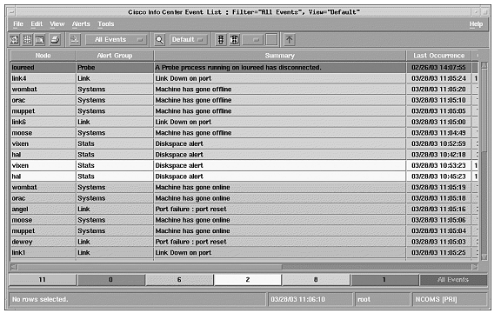
NM Tools Examples: Alarm Management Systems

Slide 58
Other Example Tools
Trouble Ticket Systems
  Used to track how problems in a network
  different from managing the alarms
Work order management systems
  Equipment installation, wiring, repair, replacement
  Management of truck rolls
  Interaction with inventory and ordering systems for spares
  Interaction with workforce planning systems
Service order management systems
  Entry of service orders
    Adding, deleting, modifying a service
  Orchestration of service order process, e.g.
    Turning on billing
    Credit card verification
    Flow-through systems to provision the service
  Tracking of service order status

Slide 59
Other Example Tools
Inventory Systems
  to track the assets of a network provider.
  Network inventory systems track physical inventory in a network
  Service inventory systems track the instances of services that have been deployed over the network
Service Provisioning Systems
  facilitate the deployment of services over a network
  very complex applications

Slide 60






  Packet Analyzers : InMon Sflow probe
http://www.caida.org/tools/taxonomy/workload.xml
Customer
  Education
  Government
The Cooperative Association for Internet Data Analysis

Slide 61
Passive Monitoring
The passive approach uses devices to watch the traffic as it passes by.
These devices can be special purpose devices such as a Sniffer, or they can be built into other devices such as routers, switches or end node hosts
The passive monitoring devices are polled periodically and information is collected (in the case of SNMP devices the data is extract from Management Information Bases (MIB)) to assess network performance and status.
The passive approach does not increase the traffic on the network for the measurements.
It also measures real traffic. However, the polling required to collect the data and the traps and alarms all generate network traffic, which can be substantial. Further the amount of data gathered can be substantial especially if one is doing flow analysis or trying to capture information on all packets.
The passive approach is extremely valuable in network trouble-shooting, however they are limited in their ability emulate error scenarios or isolating the exact fault location.
Since the passive approach may require viewing all packets on the network, there can be privacy or security issues about how to access/protect the data gathered.
http://www.slac.stanford.edu/comp/net/wan-mon/passive-vs-active.html

Slide 62
Active Monitoring
The active approach relies on the capability to inject test packets into the network or send packets to servers and applications, following them and measuring service obtained from the network. As such it does create extra traffic, and the traffic or its parameters are artificial.
On the other hand, the active approach provides explicit control on the generation of packets for measurement scenarios. This includes control on the:
    nature of traffic generation,
    the sampling techniques, the timing, frequency, scheduling, packet sizes and types (to emulate various applications), statistical quality, the path and function chosen to be monitored. Being active implies testing what you want, when you need it. Emulation of scenarios is easy and checking if Quality of Service (QoS) or Service Level Agreements (SLAs) are met is relatively straightforward.

Slide 63
Passive And Active Monitoring
Given the complementarily of the two mechanisms, we need to explore ways to get the best of both worlds.
A possibility is for the active measurement probe to schedule passive measurements of appropriate metrics at appropriate points along the path, while the active measurements are being made. When the active measurement is completed then the appropriate passive measurements can be paused thus reducing the gathering of unnecessary data.
By comparing and contrasting the active and passive measurements, the co-validity of the different measurements can be verified, and much more detailed information on carefully specified/scheduled phenomena are made available.

Slide 64
NetFlow
Cisco NetFlow is a Cisco developed flow technology that allows bandwidth monitoring of a network. NetFlow Analyzer is a software that uses Cisco NetFlow to monitor bandwidth and runs in windows and linux.
NetFlow packet details¹
  Source and destination IP address
  Input and output interface number
  Source and destination port number
  Layer 4 Protocol
  Number of packets in the flow
  Total Bytes in the flow
  Time stamp in the flow
  Source and destination AS
  TCP_Flag & TOS
http://www.manageengine.com

Slide 65
Outline
What is Network Management?
Why Network Management?
Who is Who in Network Management?
What is going in Real Network Management Systems?
Why is Network Management Challenging?
Network Management Evolution

Slide 66
Challenges
Network management is a complicated process
  Very wide
    Various functionalities, Different objective, …
  With many details
    All protocols in networks need to be managed!!!
  From different perspectives
    Technical issues, Managerial issues, Human!!
Challenges
  Technical challenges
  Organization and operation challenges
  Business challenges

Slide 67
Challenges Example: Technical
The first and obvious set of challenges
  NM system is a very big and complex SW, general issues:
    SW architectural design issues
    Appropriate technologies
    Development & documentation
    Test & troubleshooting
NM context issues:
  Application characteristics
  Scale
  Technology cross-section
  Integration

Slide 68
  Technical Challenges: Application characteristics
NM is composed of different functionalities (e.g., FCAPS)
  These functionalities are implemented by specific applications
    Have own requirements and characteristics from SW engineering point of view
Some example (common) characteristics
  Transaction-Based System Characteristics
  Interrupt-Driven System Characteristics
  Efficient Data Analysis System Characteristics

Slide 69
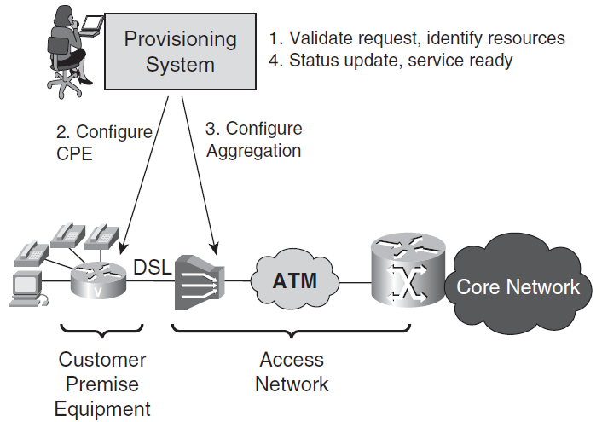
  Transaction-Based Characteristics
Network configuration for service provisioning
  Rollback in the case of any failure/error

Slide 70
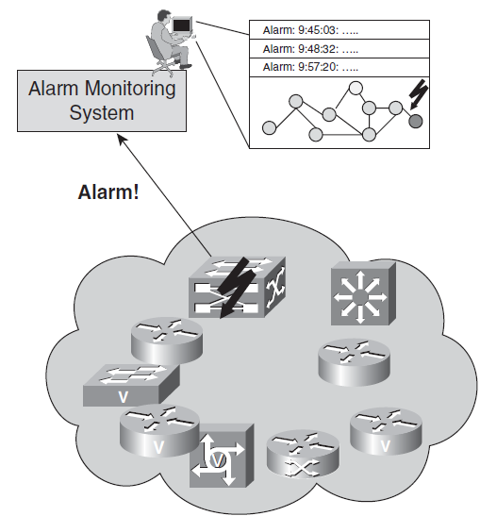
  Interrupt-Driven Characteristics
Network health tracking is an objective of NM
  Devices inform events to manager through alarm message → unsolicited message (interrupt)
Challenges
  Real-time processing & response
  High volume of interrupts
    E.g., a broken router
      Multiple physical link failure alarms
      So many service disruption alarms
      Unexpected routing updates
      ….

Slide 71
  Efficient Data Analysis System Characteristics
Operators need to analyze network performance to
  Identify bottlenecks,
  Guarantee SLA
  Evaluate utilization of network resources
  Understand traffic patterns
  Analyze trends for future network planning/design
Challenges
  Gathering large volume of data
  Processing data
  Statistical analysis and interference
    Efficient & complex algorithms

Slide 72
Technical Challenges: Scale
Computer networks are large scale systems
  Scalability is a fundamental requirement in NM
Scalability needs proper design and technologies
  NM for ~100 node is complete different from NM for ~10000 node!
As a general rule scalability is a SW architecture problem rather than HW platforms
  While hardware performance is increasing, NM processing requirements increase more

Slide 73
Technical Challenges: Technologies
Many different technologies need to be used to build a NM system: Many technologist with different expertise
Examples
  Information modeling
    How network devices, links, service, management parameters, … are modeled?
  Database
    How to design required NM DBs (devices, links, services, customers, configurations, …)
  Distributed computing
    By definition, NM is distributed computing
      Moreover, to achieve scalability & reliability, distributed computing is needed
  Network (L4-L7) protocols
  User interface
    Visualization of large volume of data efficiently & user-friendly
    Support large number of user for customer care software

Slide 74
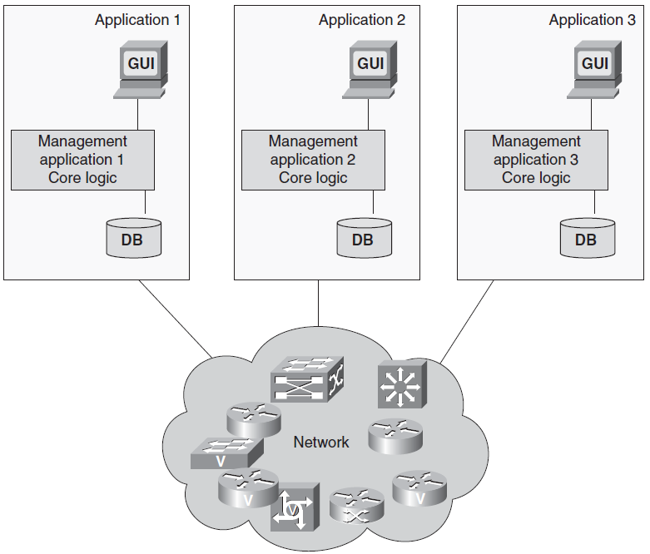
Technical Challenges: Integration
Swivel-chair syndrome

Slide 75
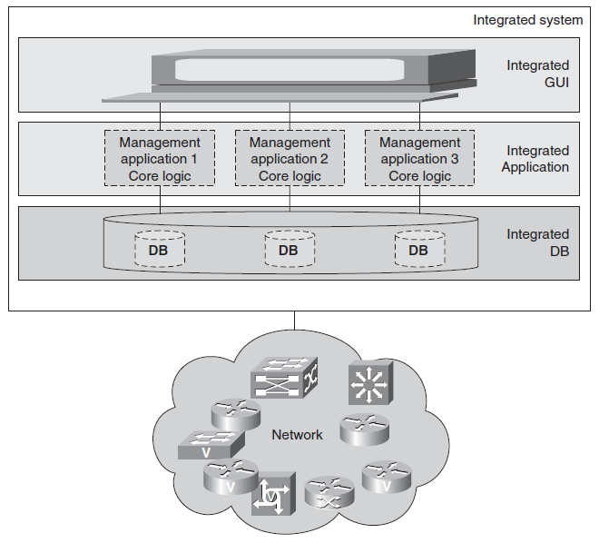
Technical Challenges: Integration
Make different NM applications as if they were a “NM system”

Slide 76
Organization & Operations Challenges
How human are organized for NM is an issue
  Large enterprises with IT departments
  Service provider networks (e.g., TIC)
It is an other dimension (rather than technology) for successful network management
How to divide the tasks of NM?
  It is not easy, eTOM tried to answer
How to organize and mange people to perform tasks
  Again is not easy, depends on human factors

Slide 77
Organization & Operations Challenges
Common tasks
  Network planning
  Network deployment
  Network operation
  Network maintenance
  Workflow management
  Inventory management
  Order & Billing management
  Security management

Slide 78
Outline
What is Network Management?
Why Network Management?
Who is Who in Network Management?
What is going in Real Network Management Systems?
Why is Network Management Challenging?
Network Management Evolution

Slide 79
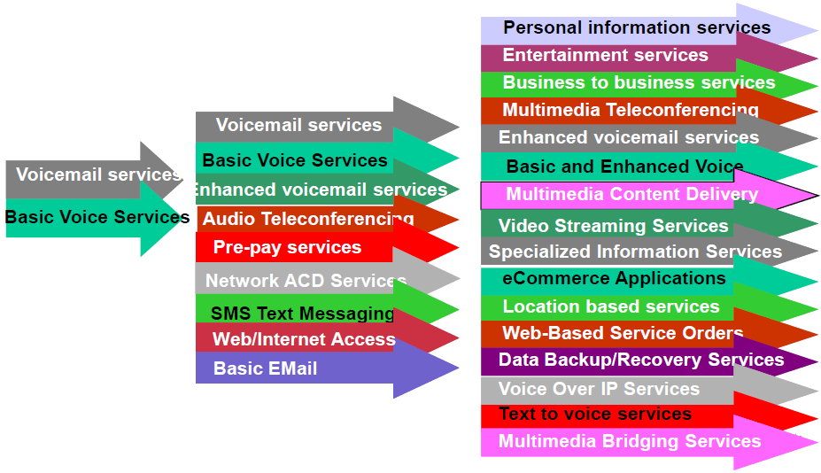
Telecommunications Services Evolution

Slide 80
Customer Demand Evolution
Traditional networks
  Residential customers & corporate networks
    Simple process for requesting basic or enhanced services
Today
  Business customers
    Bandwidth and service on demand
    Electronic interfaces for requesting services or changes, reporting trouble, and billing
    Quick provisioning time and QoS

Slide 81
Management Functionality Evolution
Traditional (PSTN) networks
Circuit switching: F > C > A > P > S
  Fault = service disruption
  Configuration = service provisioning
  Per call accounting = Business
  Ignore performance since resources are reserved
  No security

Slide 82
Management Functionality Evolution
Next Generation Networks (NGN)
Data/Multimedia IP networks:
  S > P > A ~ C ~ F
  Security is the essential requirement
  Efficient resource utilization through Performance management
  Bulk bandwidth or usage based accounting
  Misconfiguration and faults are tolerable in some cases

Slide 83
Network Management Vision Evolution
Traditional management
  Element management
    Get/Set device management parameters
    Get alarms from equipments
Current trend (vision)
  Service & Business management
  Process & Workflow management
  TeleManagement Forum (TMF) is the driving force behind this vision

Slide 84
Summary
What is Network Management?
  OAM&P or FCAPS or FAB or …
Why Network Management?
  Cost and Revenue is determined by it
Who is Who in Network Management?
  NM Provider (Equipment, NP Application, Integration) & NM Users (Service Providers, End users)
What is going in Real Network Management Systems?
  Many applications in NOC
Why is Network Management Challenging?
  Technical, Organizational, …

Slide 85
References
  Reading Assignment: Chapter 1 & 2 of “Alexander Clemm, ‘Network Management Fundamentals’ , Cisco Press, 2007”
  Alexander Clemm, “Network Management”, Santa Clara University, http://www.engr.scu.edu/~aclemm
  Woraphon Lilakiatsakun, “Network Management”, Mahanakorn University of Technology, http://www.msit2005.mut.ac.th/msit_media/1_2553/ITEC4611/Lecture/
  J. Won-Ki Hong, “Network Management System”, PosTech University, dpnm.postech.ac.kr/cs607/

