Slide 1
Basic Concepts
Network Management
Bahador Bakhshi
CE & IT Department, Amirkabir University of Technology
This presentation is based on the slides listed in references.

Slide 2
Outline
Introduction
Managed Devices: Agents and MIBs
Managing Systems
Management Network
Management Support Organization

Slide 3
Outline
Introduction
Managed Devices: Agents and MIBs
Managing Systems
Management Network
Management Support Organization

Slide 4
Introduction
Until now, we know
  What network management is
  Why it is important
  What Challenges are
  Who major players are
What does NM consist of?

Slide 5
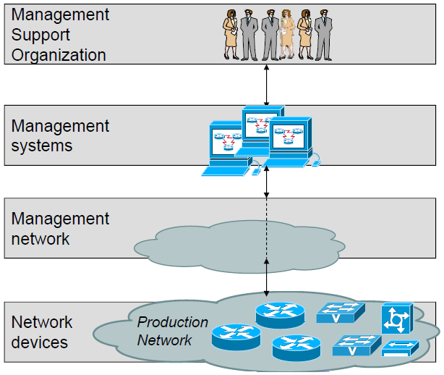
The Basic Ingredients of Network Management

Slide 6
The Basic Ingredients of Network Management
Notes:
What does a NMS consist of?

Slide 7
The Basic Ingredients of Network Management
Notes:
What does a NMS consist of?

Slide 8
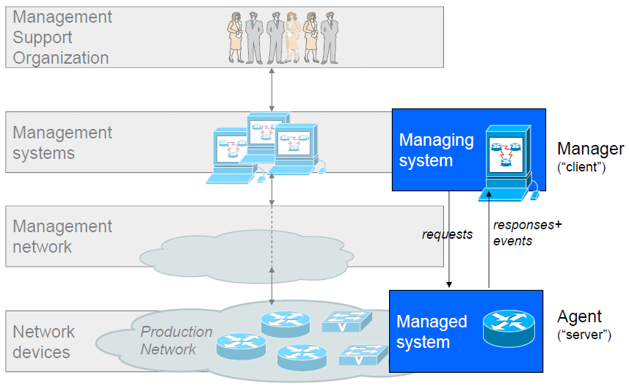
Basic Management Architecture

Slide 9
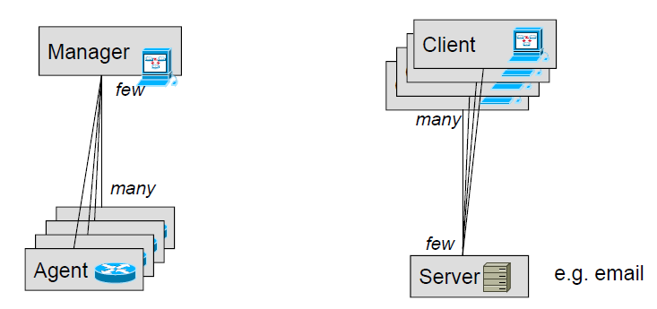
Basic Management Architecture (cont’d)
The architecture is the Client-Server paradigm
  Client = Manager, Server = (management) Agent
  But in reverse order of other typical applications

Slide 10
Outline
Introduction
Managed Devices: Agents and MIBs
Managing Systems
Management Network
Management Support Organization

Slide 11
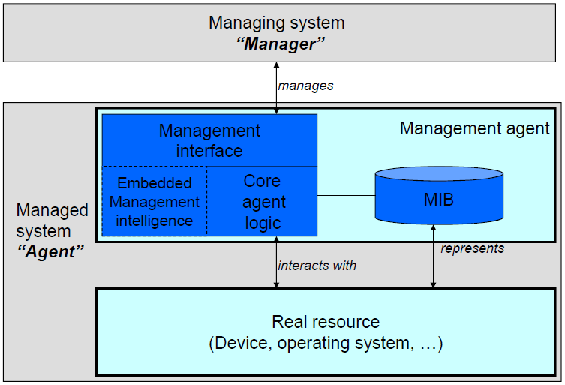
Managed Devices
What’s in a managed system
Notes:
This slide has a lot to say!!!

Slide 12
What’s in a Managed System
Management interface
  Allows manager to interact with agent
    CLI, GUI, API, …
  Typically, is a management protocol
    Application layer protocols with management primitives
      Report an event, Apply a configuration, Export an accounting detail record, …
    Managers use SDK/APIs to hide protocol specifics from application developers
      Marshalling/unmarshalling parameters

Slide 13
What’s in a Managed System (cont’d)
Multiple management interfaces exist, often on the same device
  Examples: CLI, SNMP, Netconf, syslog, Netflow
  Some have different purposes
    Collection of data for accounting purposes
    Configuration/provisioning of a box
    Monitoring for alarms and faults
  Some have overlapping purposes
    Historical reasons
    Network manager preferences/ user choice

Slide 14
What’s in a Managed System (cont’d)
MIB – Management Information Base
  Conceptual representation of the managed device
  Management operations are directed against this conceptual view
  A “model” of the device, or rather an instance of a model
    Think about configuration parameters, state, performance statistics as entries in a the database
      Ports of a router are represented as a table
      Each port is a row in the table
      Each column is an attribute of port (# of send packets, IP, mask, …)
  Don’t confuse with a “real” database
    Data represents real resources (e.g. device registers, hardware state, policies for device behavior)

Slide 15
MIB
An overloaded term
  Here:
    A conceptual representation of a managed device by a management agent
    The collection of all management information that is exposed by a network element to managing applications (the view of management information)
  SNMP:
    Management information accessed through an agent
    A specification of a management information model to be implemented by SNMP management agents

Slide 16
What’s in a Managed System (cont’d)
Core agent logic
  Naming/addressing of management information
    E.g. Management Information Tree
  Translation between internal and external representations
  Interact with OS to perform management requests
    Get & Set parameters
    Get asynchronous notification → Alarm

Slide 17
What’s in a Managed System (cont’d)
Management intelligence (optional)
  “Value-added” functionality for the purpose of facilitating management
  Automation of certain procedures
  Correlation and filtering of events
  Aggregation and preprocessing of management information
    e.g. flow information, statistical analysis
  Measurement of service levels
  Anomaly detection, Intrusion detection
  …

Slide 18
What’s in a Managed System (cont’d)
Manageable resources
  Hardware components; e.g., NIC
  Software components; e.g., OSPF daemon
In addition to their own functionalities, provide manageability facilities
  Management parameters
    Subset of the parameters are standard
  Management interface
    Usually vendor specific

Slide 19
Agents vs. Resources
A managed device can contain multiple management agents, each realizing a different management interface
  Often specialized towards different tasks: configuration, monitoring, accounting...
  Each management agent offers its own view of underlying resource
    Example: reference to an interface in a CLI, an API, a URL, an SNMP object
All the agents manage the same resources

Slide 20
Summary

Slide 21
Outline
Introduction
Managed Devices: Agents and MIBs
Managing Systems
Management Network
Management Support Organization

Slide 22
What’s in a Managing System
Are all the SW applications used for NM
Software engineering architecture
  Model-View-Controller a popular design pattern
  N-tier architectures decouple communication – application – interfaces
  General concepts of modern software engineering of large scale applications apply
    Distribution
    SOA: Loose coupling
    High-availability

Slide 23
What’s in a Managing System
Common components
  Communication handlers
    Event handlers
    Data collectors
    …
  Abstraction layers to normalize interface variations
  Databases (to store network inventory)
  Workflow engines
  GUI components

Slide 24
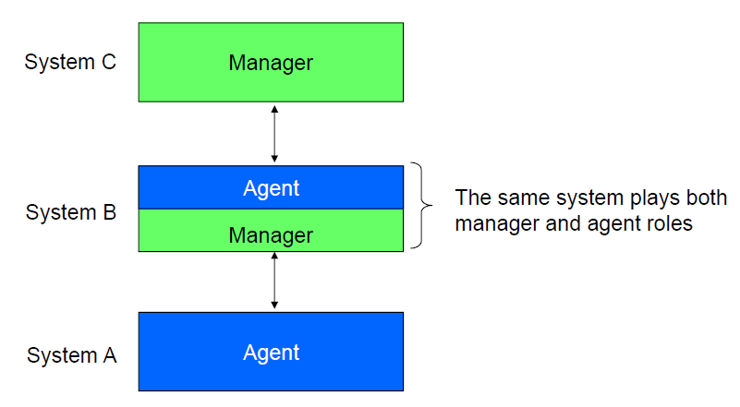
Management Hierarchies

Slide 25
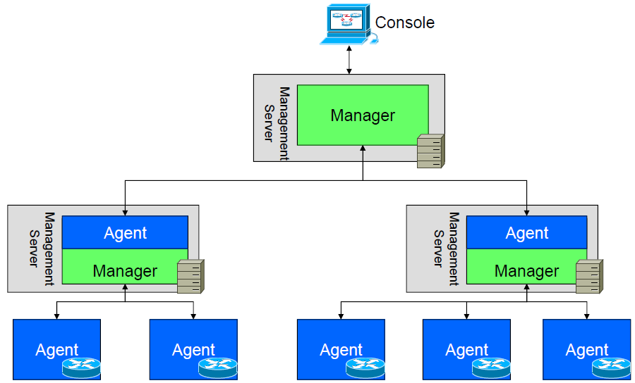
Example: MOM – Manager of Managers

Slide 26
Outline
Introduction
Managed Devices: Agents and MIBs
Managing Systems
Management Network
Management Support Organization

Slide 27
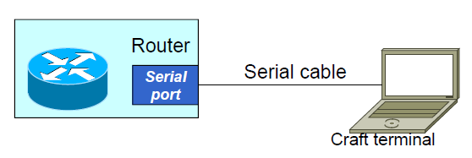
Manager to Device Connectivity
Connectivity between managing and
managed systems?
Multiple ways to connect a device to a management station
  Through a dedicated port (console port)
    For basic configuration & troubleshooting

Slide 28
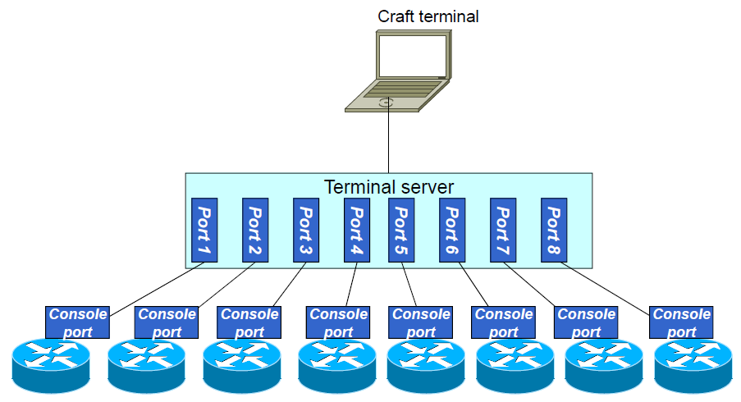
Manager to Device Connectivity (cont’d)
Is not suitable for practical NM
  Many terminal servers
  Keep track which route is connected to which port
  Serial port!!!

Slide 29
Manager to Device Connectivity (cont’d)
Connectivity between managing and
managed systems?
Multiple ways to connect a device to a management station
  Through a dedicated port (console port)
  Through a dedicated interface, with the device configured such that management traffic is passed through the interface
    Two port types: Data & Mgt Ethernet interfaces
      Different route cards: Supervisory engine card (mgt) & Line card (data)
    Out-of-band management
      Management traffic is not mixed with data traffic
    Needs dedicated network for NM, Why??!!!

Slide 30
Manager to Device Connectivity (cont’d)
Connectivity between managing and managed systems?
Multiple ways to connect a device to a management station
  Through a dedicated port (console port)
  Through a dedicated interface, with the device configured such that management traffic is passed through the interface
  No specific connection at all, data port is used for NM
    In-band management: NM traffic is part of other traffic
    Chicken or Egg problem!
      Data routing need management while management uses data path

Slide 31
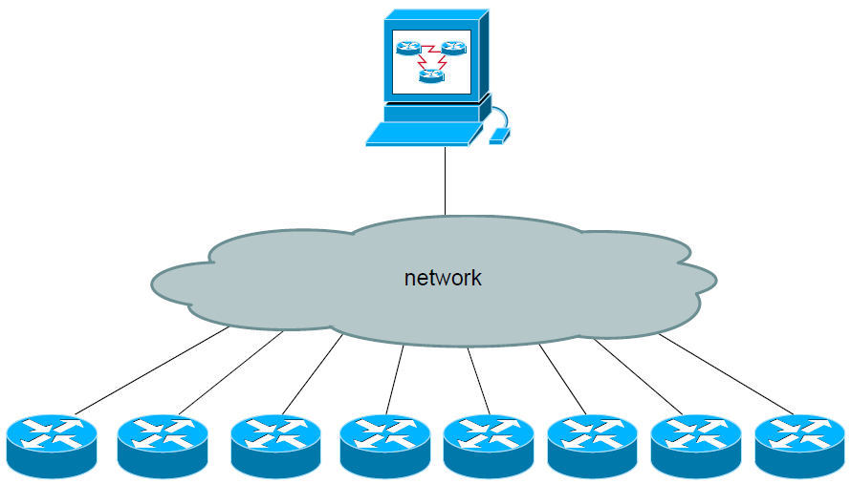
Manager to Device Connectivity (cont’d)

Slide 32
The Management Network
Production traffic vs. Management traffic
  Production traffic carries the customer services
    Network devices are not destination of it
      Transient nodes for this kind of traffic
  Management traffic is management protocols packets
    Network device is the destination for management traffic, not just a transit station
      Management traffic hence is addressed at the network device itself, as opposed to a connected end system
Out-of-band management: Dedicated physical network for management traffic
In-band management: Management network overlayed on top of production network

Slide 33
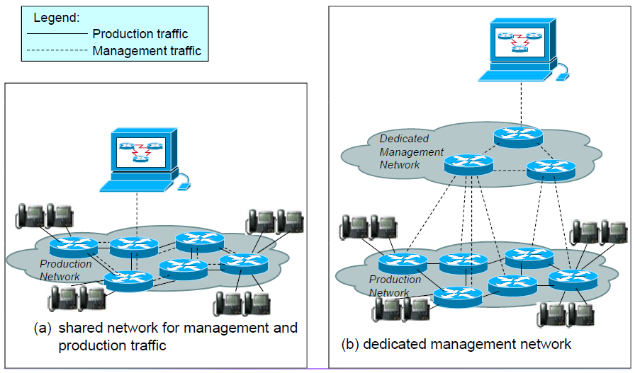
The Management Network (cont’d)

Slide 34
The Management Network (cont’d)
Pro dedicated management network
  Reliability
    No issue “getting through” when network problems occur
  Interference avoidance
    No competition with production traffic
  Ease of network planning
    No additional category of “service” to take into account
    But: a separate network needs to be planned
  Security
    Users + subscribers never come into contact
    Easier to secure, less (external) vulnerabilities, e.g., DDoS
Cost?!
Management of the management network?!

Slide 35
The Management Network (cont’d)
Pro shared management network
  Cost and overhead
    Huge price tag! Equipment, space, cabling…
  Practicality
    Separate lines sometimes not a practical option
    Remote sites, customer premises equipment
In practice, management networks almost always share with production networks
  Save a few, very rare exceptions with critical service provider infrastructure

Slide 36
The Management Network: Consideration
How do we ensure alarms will not get stuck in traffic?
How do we ensure network repair actions can reach their intended destination?
How do we ensure non-essential management traffic does not interfere with production traffic?
Network planning and engineering applies to management traffic like for other critical network applications (e.g., NM VPN using MPLS)

Slide 37
Outline
Introduction
Managed Devices: Agents and MIBs
Managing Systems
Management Network
Management Support Organization

Slide 38
Management Support Organization
Purpose of network management technology is ultimately to support the management organization, e.g.,
  Automate routine tasks
  Make management tasks less error prone
  Empower administrators with the proper information
  Enforce organization processes
    make sure tasks don’t fall through the cracks
  NMS is also called OSS (Operation Support System)
Management technology ultimately to be seen in that context
  How effective does it make the management organization?
  Success of network management (with this measure)
    Technical efficiency & productivity
    +
    Proper organization architecture

Slide 39
Support Organizations Hierarchy
“Horizontal” partitioning, e.g.
  Structuring management support organization by analyzing the different tasks and the workflows that they involve
    Network planning, Network operations, Network administration, Customer management
    Are not independent, but their interactions are minimized
“Vertical” partitioning, e.g.
  Global NOC (Service Provider term)
  Regional NOCs, e.g. North America/Asia/Europe
Network architecture based partitioning
  Access, Distribution, Core, …
Hybrid, …

Slide 40
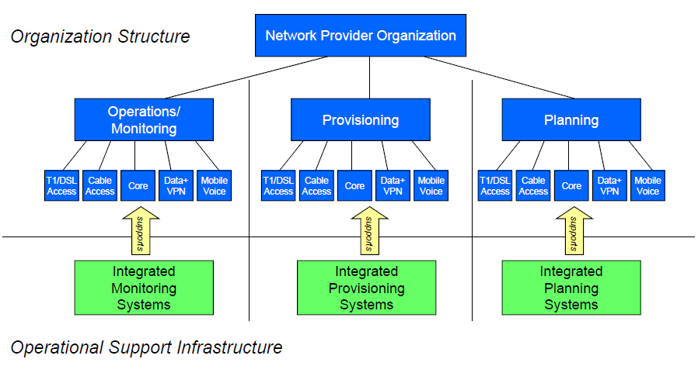
Examples for Organizational Partitioning

Slide 41
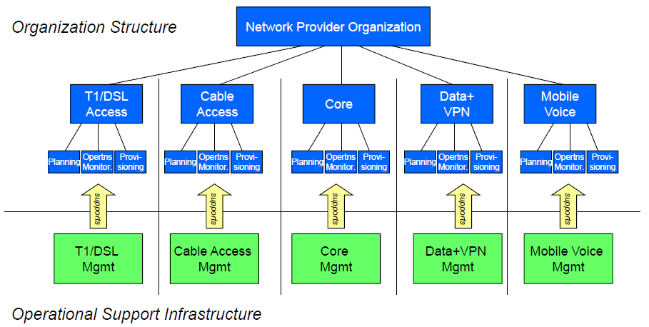
Examples for Organizational Partitioning

Slide 42
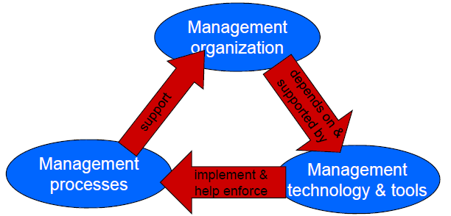
Processes
Management organization is supported by processes in addition to technology
  Guidelines, workflows to make organizational quality consistent and predictable (not ad-hoc management!)

Slide 43
Examples for Processes
Documented operational procedures
  What to do when certain events occur
Collection of audit trails and network logs
  Predefined & automated procedures for storing, backing up, consolidating reports
Network documentation
  Prerequisite for provisioning, fault isolation, …
Backup and restore procedures
  Lifeline when things go wrong: restore to last working config
Security processes
  Audit trails, backup/restore procedures important tools

Slide 44
Summary
Network management consists of
  Manageable devices
    Management agents, MIB, and MO
  Management applications
    SW application for NM functionalities
  Management network
    Out-of-band management: dedicated Mgt. network
    In-band management: overlay Mgt. network
  Management organization
    Horizontal/Vertical/… partitioning & NM processes

Slide 45
References
  Reading Assignment: Chapter 3 of “Alexander Clemm, ‘Network Management Fundamentals’ , Cisco Press, 2007”
  Alexander Clemm, “Network Management”, Santa Clara University, http://www.engr.scu.edu/~aclemm
  Woraphon Lilakiatsakun, “Network Management”, Mahanakorn University of Technology, http://www.msit2005.mut.ac.th/msit_media/1_2553/ITEC4611/Lecture/
Thomas Cavaiani, “Network Management”, Biose State University, http://telecomm.itmbsu.net/itm460.fall.2012/index.html

