Slide 1
Network Management Protocols
Network Management
Spring 2013
Bahador Bakhshi
CE & IT Department, Amirkabir University of Technology
This presentation is based on the slides listed in references.

Slide 2
Outline
Network Management Protocol
Communication Patterns
SNMP
CLI
syslog
Netconf
NetFlow/IPFIX

Slide 3
Outline
Network Management Protocol
Communication Patterns
SNMP
CLI
syslog
Netconf
NetFlow/IPFIX

Slide 4
Introduction
Interactions between managers and agents follow certain basic patterns
  Regardless of the particular management protocol
The pattern includes
  Management protocol layering
  Manager initiated communications
  Agent initiated communications

Slide 5
Layers of Management Interactions
Network management is based on protocols stack (the layering)
  Similar to other networked applications
Management protocol is an application layer protocol
  Provides primitives for management applications
    E.g., Whole web application use HTTP
To simplify & organize the discussion
  Layering of network management protocol

Slide 6
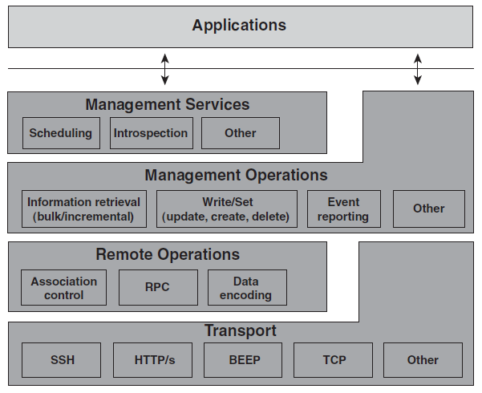
Network Management Protocol Layers

Slide 7
NM Protocol: Transport
A L4/7 protocol for end-to-end communication
  In fact, it is a separated independent protocol
However, NM protocols impose restrictions on transport protocols
  Make assumptions and depend on it
  Management interface specifies it
E.g.,
  SNMP: UDP
  NetConf: RPC on SSH on TCP

Slide 8
NM Protocol: Remote Operation
Mechanism to implement performing remote operations
  Are not a separated protocol
  Are provided by the management protocol
  May not present in every NM protocol
Major functionalities
  Association control
  Remote operation call/invocation
  Payload encoding

Slide 9
NM Protocol: Remote Operation (cont’d)
Association control
  How to establish and tear down management sessions
    It is independent of transport protocol: connection oriented/less
  Mutual understanding between manager and agent that transport protocol is not aware of
    E.g., to negotiate a particular functional profile to use
Remote operation
  Mechanism to delineate management requests and responses in communication exchanges, E.g., RPC
    Managing Request/Response IDs because of asynchronous communication due to its efficiency
Encoding
  How to encode management data in PDU: BER, XML, UTF-8, …

Slide 10
NM Protocol: Management Operations
The core of management protocol stack
  Management primitives
Typical operations
  Read/Get: To read the value of a MO
  Write/Set: To modify the value of a MO
    Create or Deletion of a MO
  Event: To report occurrence of event to manager
  Action: To perform an operation on agent
  Some rarely used: subscribe, …
Not every protocol provides all operations

Slide 11
NM Protocol: Management Service
Additional offering to management applications
Builds itself on the Management Operations layer
  Combine the management primitives with additional capabilities
Examples
  Subscription to specific events
  Scheduling management operations
Actually management services are not really a layer because management operations are still accessible to management applications

Slide 12
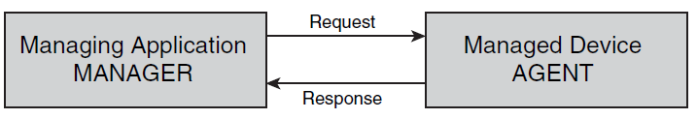
Manager-Initiated Communications
Request-Response paradigm
  A manager makes a request
    To get/set/create MO or perform action
    Includes request type, parameters, and headers
  Agent sends a response
    Includes a return code, result, and headers

Slide 13
Manager-Initiated Communications
Information Retrieval: Polling
  Basic types
    Requests for Configuration Information
    Requests for Operational Data and State Information
  Advanced types
    Bulk Requests and Incremental Operations
    Historical Information
Configuration Operations
  Main issue: Failure Recovery
Actions

Slide 14
Manager-Initiated: Information Retrieval
Polling mechanism steps:
The manager asks the agent for a particular piece, or pieces, of management information
The agent checks the validity of the request and retrieves the requested information
The agent then responds,
  The requested information
  An error-response code why request could not be fulfilled
An error message is sent in case the agent
  Does not understand the request
  Does not know the type of management information

Slide 15
Polling (cont’d)
Requests for configuration information
  Physical or logical configuration information
    Discovery, Provisioning, Fault, …
  Typically infrequent and (maybe) external changes
    Caching is efficient → Management DBs
Requests for operational and state information
  Network monitoring → Fault detection, performance, accounting, …
  Manager cannot change the information
  Typically frequent changes
    (Typically) no Caching DB; on demand snapshots
These requests can also be
  Bulk request: Ask several MO which has the same attributes
  Historical information: Snapshot of management data in an interval

Slide 16
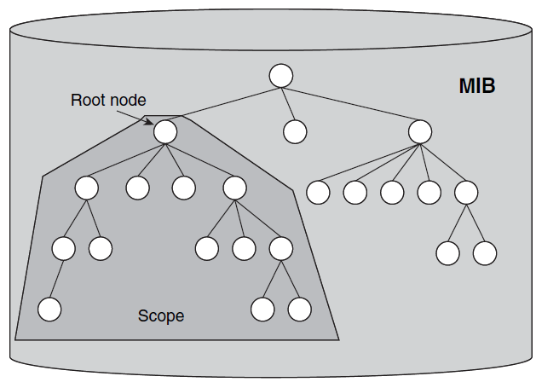
Bulk Request
Bulk request operation when MIB view is a tree

Slide 17
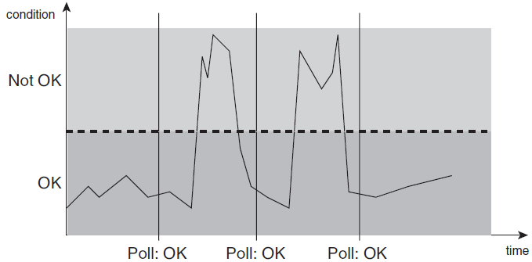
Polling Disadvantage
Frequent polling
  Expensive & High overhead : high management traffic!
Infrequent polling
  Miss critical condition
  Long delay to find out critical conditions

Slide 18
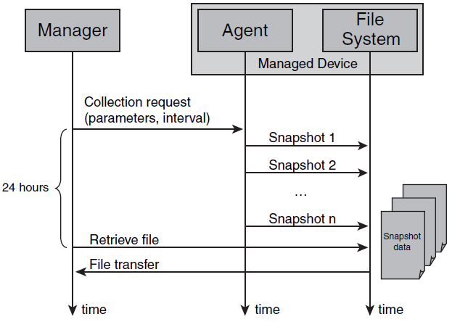
Alternative Polling Mechanism
Advantage? When is applicable?

Slide 19
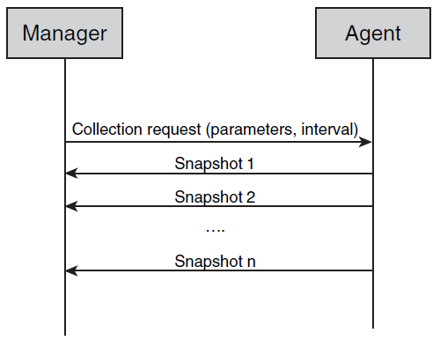
Alternative Polling Mechanism (cont’d)
Advantage? When is applicable?

Slide 20
Manager-Initiated: Configuration
To change configuration information
Parameter settings to affect agent’s behavior
Some aspects are fundamentally different from information retrieval requests
  Failure recovery
    Failure in configuration is much more than information retrieval
    Configuration is much more sensitive to failures
  Response
    Response of configuration requests are typically a success/failure status code not huge data

Slide 21
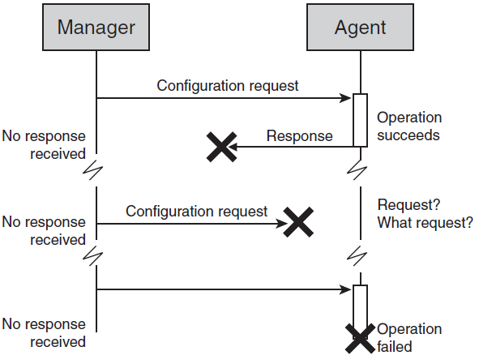
Configuration Operation: Failure
It is not easy to handle failures in configuration
  Different failures
  Different configuration (behavior effects)

Slide 22
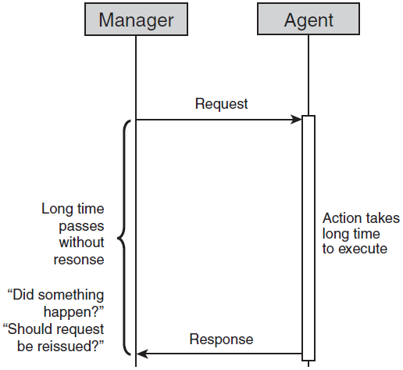
Manager-Initiated: Actions
To request device to perform certain action: self-test, ping,…
  Manager requests an action
  Agent runs the action and sends the output

Slide 23
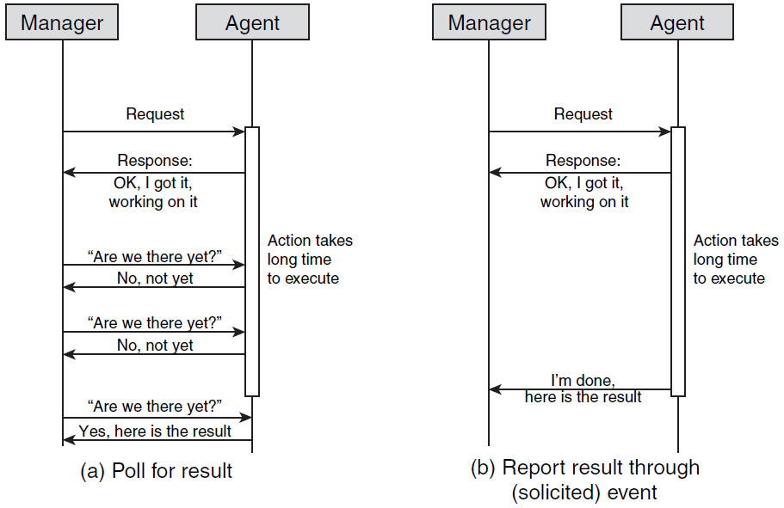
Manager-Initiated: Actions (cont’d)

Slide 24
Agent-Initiated Communications
Agent sends the manager an event (trap) message to bring something to the manager’s attention
  Event messages correspond to interrupts that help managers do their jobs better
    Unsolicited communications
Categories
  Alarms: Requires management attention
  Configuration-change: Inform of a configuration change in the device.
  Threshold-crossing: Performance-related state variable has exceeded a certain value
    Might require management attention
  Logging: Occur regularly in network operation
    Typically, do not require an operator’s attention
    But need to be logged

Slide 25
Event Messages
The included information in event messages:
The system from which the event originated
  IP, Name, ID, …
A time stamp of when the event occurred
The type of event that has occurred
  Security, Fault, ….
Event detail information

Slide 26
Event: Alarms
Alarm: unexpected event has occurred that likely requires management attention
Examples
  Router line card failure
  Loss of connectivity
Alarm: condition that persists over a period of time; two states
  On: Abnormal condition starts
  Off: Conditions back to normal case
Additional information in alarm messages
  Alarm severity: Critical, Major, Minor, Warning, Cleared
  Additional information to troubleshoot the alarm

Slide 27
Event: Configuration Change
1) Many applications need accurate information of network configuration
2) Due to infrequent changes, configuration information are cached
3) Configuration can be modified externally (not through the NM application), e.g., CLI
1 + 2 + 3 → configuration change event
  To keep update the cache
    Without wasting bandwidth
    Without out-of-date cache periods

Slide 28
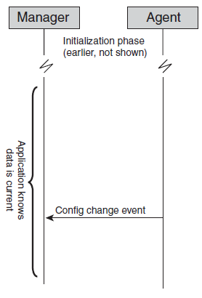
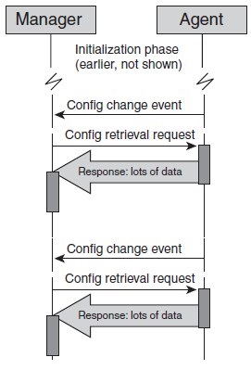
Event: Configuration Change
Ideal
Practice
Modified MOs
New Values
Source of change
Config modified!

Slide 29
Event: Threshold Crossing
A monitored MIB (MO) has crossed a certain preconfigured value (threshold)
Similar to alarms
  Two states: on & off
Information included in this event
  The name & value of the monitored MIB
  The value of the threshold
  Whether the threshold has been crossed or cleared
Oscillation around the threshold
  Lot of cross & clear events
  Hysteresis threshold to clear the event

Slide 30
Event vs. Polling
Event-based management is more efficient
  Less wasteful, more scalable, more responsive
    Wherever possible, event-based management should be the pattern of choice
However; event-based is not possible in every case (is not efficient & convenient)
  Example: Service provisioning
Event reliability
  In polling based, initiator wait for response → can detect failures
  In event based, initiator does not need response
    Reliable transport protocol
    Request acknowledge for events

Slide 31
Outline
Network Management Protocol
Communication Patterns
SNMP
CLI
syslog
Netconf
NetFlow/IPFIX

Slide 32
SNMP
Simple Network Management Protocol
  Widely, successful
  To retrieve operational data
Original SNMP: SNMPv1
  Keep SNMP agent implementations simple
  User extensible with new management information
Current version: SNMPv3
  Not quite as simple, more complex than original one
  Adds security and scalability to design goals
SNMPv1, SNMPv2c and SNMPv3 all in use today

Slide 33
SNMP Standard
SNMP is a series of IETF RFCs:
1) The protocol itself
2) The MIB specification language
  SMI
  SMIv2
3) Series of standard MIB definitions
4) The architecture of agent implementations

Slide 34
SNMP Fundamental Principles
Separate definition of management information from definition of management protocol
Management information
  Specified in MIB modules
  MIB specification language (SMI, SMIv2)
  Extensible by users: Enterprises can define their own
  Standardized MIB modules for commonly used information available
Management protocol itself
  Fixed set of basic services that operate on management information
    Retrieve and modify information, report events
  Encoding of management information: Basic Encoding Rules (BER)
  Not extensible by users

Slide 35
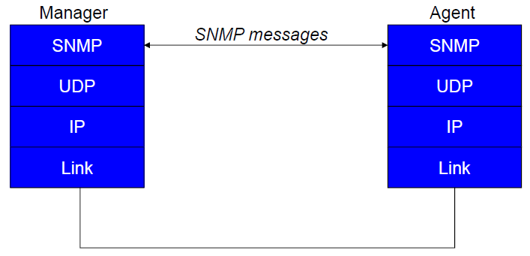
SNMP Protocol Stack

Slide 36
SNMP Operations
Get request
  Get value of a MIB object
  Specify one or more OIDs of objects to retrieve
  Can request several OIDs in a single request/response
Get-next request
  Get value of a MIB object
  Specify one or more OIDs
  Value of closest lexicographical successor is returned
Set request
  Set a MIB object to a specified valued
  Can specify one or more OIDs to set

Slide 37
SNMP Operations (cont’d)
Get-response
  Really, a request response – sent for get, get-next, set
  The requested OIDs and object values
  Includes request identifier
    SNMP is connectionless
Trap
  Unconfirmed event
  Who emits the trap, what type of trap occurred, when did it occur
  Tuples of OIDs and object values with additional info

Slide 38
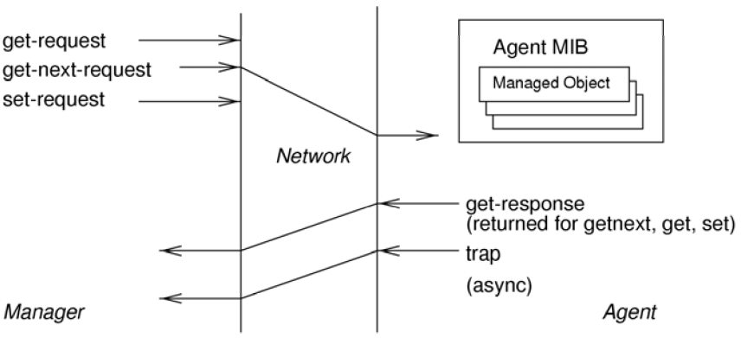
SNMP Operations (cont’d)

Slide 39
Actions in SNMP
SNMP does not provide the ability to invoke an “action”
  Retrieve or Set management information,
    But do not cause the device to “do” something
Work around: model actions as management information
Action Design Pattern:
  One MIB object to serve as “action trigger”
    MIB objects for input parameters, as required
  One MIB object to contain return code

Slide 40
SNMPv1 Evolution
SNMPv1 design goals
  There’s a big “S” in SNMP
  Focus on easy implementation on agent devices
    Many vendors were interested to implement it
  Separation between protocol operations and management information visionary at the time
  → Wide success due to the design choices
However, SNMPv1 drawbacks motivated development of newer SNMP versions
  SNMPv2c, SNMPv3
MIBs can be used with newer protocol versions
SNMPv1 continues to be widely used

Slide 41
SNMPv2c
Addresses some of the bulk retrieval issues, unreliability issues
Does not address security issues
  SNMPv2 tried to but security model broken
  SNMPv2 used in conjunction with community strings termed SNMPv2c – “SNMPv2 with Community strings”
Adds two new operations
  Inform request
  Get bulk request

Slide 42
SNMPv3
“SNMPv2c plus security”
No changes to SNMP operations
Additions
  SNMP messages can carry proper security parameters
    This is the most important change
  Significant expansion of scope
    Includes standardized and modularized architecture for SNMP agent implementations
    Does not affect interoperability aspects between agents and managers

Slide 43
SNMPv3 Assessment
SNMPv3 is, finally, a secure protocol
  This means, “sets” are secure
  Could be used for provisioning and configuration
  Too late?
    Management apps developed their workarounds, learned to live with limitations
    SNMP data models may be awkward for provisioning operations
      Lack of task orientation
      Lack of transaction support
    New, more powerful protocols for configuration (e.g. Netconf)
It is also far more complex than the original SNMP
IETF does not pursue further evolution of SNMP

Slide 44
Outline
Network Management Protocol
Communication Patterns
SNMP
CLI
syslog
Netconf
NetFlow/IPFIX

Slide 45
CLI
Command Line Interface
Administrator interface for networking devices
  It is for human operator to interact with the device
  Not intended for (but also used by) electronic applications issues
Accessible via Console, Telnet, SSH
Very comprehensive and complete
  Anything you can configure you can do through CLI
  Most (not all) information can be viewed using CLI
Not a standard – different flavors exist but same concepts
  Different vendors – Cisco, Juniper, Huawei, …
Not fixed set of command, new features add new commands
  Different from SNMP which has fixed set of primitives

Slide 46
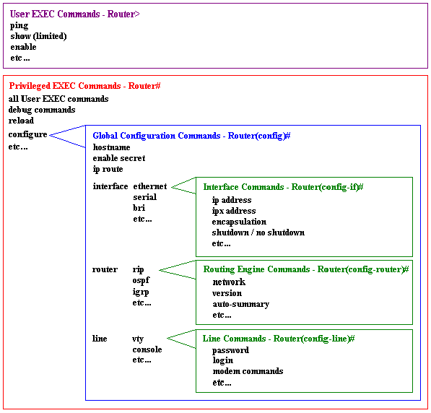
Cisco IOS CLI
Internet Operating System
OS on the vast majority of Cisco routers and switches
Different access levels:
user EXEC: view information, status, statistics, config
privileged EXEC: control the router (e.g. change how it is configured)
Switch from user to privileged EXEC using “enable” command

Slide 47
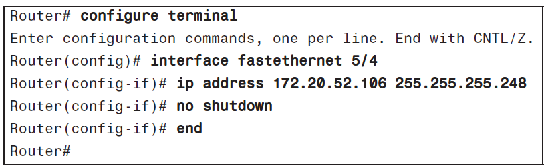
Cisco IOS CLI Example
Configuration of IP address on an interface

Slide 48
Configs in CLI
Running config
  The configuration currently in effect
  Resides in RAM
  Volatile: lost if device is restarted unless saved to NVRAM
Startup config
  The configuration that takes effect when device starts up
  Resides in NVRAM (non-volatile RAM)
  Can think of config as a file
    Contains commands that are executed when the device starts up
    Subject to back up, restore, FTP, …
    Running config is internally not a file, but generates corresponding file when persisted

Slide 49
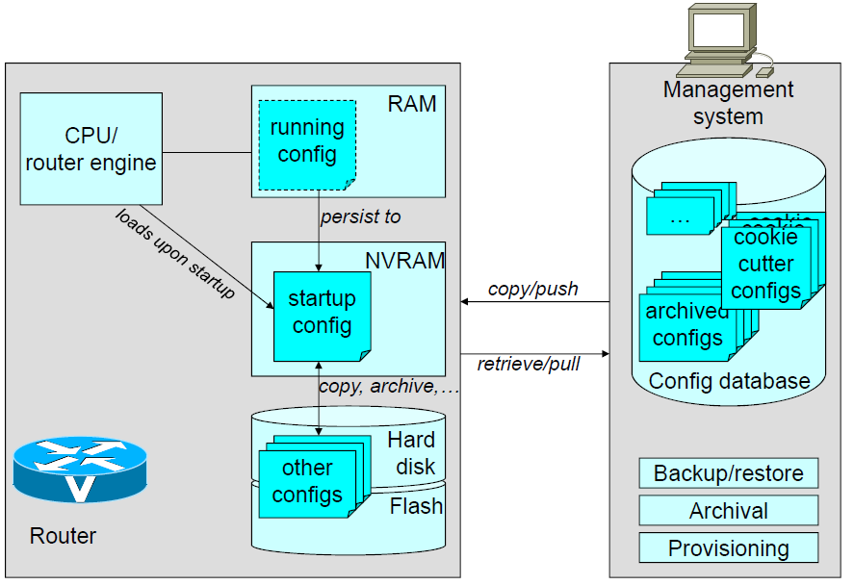
Configs in CLI & NMS

Slide 50
CLI for Humans
Many features to simplify interactions
  Help functions, Autocompletion, History, Editing, …
Very rich set of functionality
  Literally, thousands of commands
  Every new features extends the set
    New options/ subcommand modes
    Additional information that can be retrieved
Commands highly productive for human administrators
  Large user base, trained work force

Slide 51
CLI as an Electronic Interface
CLI intended for humans, not management applications
So why even consider it
  Very rich set of functionality
  Not all features are covered via SNMP or other management interfaces
Successfully used with provisioning systems
  Limited set of commands needed
  Information flows from NMS to managed device
  In many cases: management system does not issue command directly but manages configuration files

Slide 52
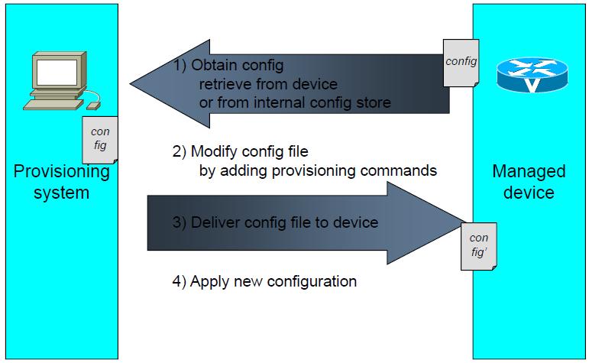
Example: CLI in Provisioning

Slide 53
CLI Issues
How to process the response
  Easily interpretable by humans, not so easily by applications
No consistent grammar
  Different delimiters
  Parameter labels: in front, or after, or not at all
  Horizontal or vertical arrangements (tables)
  show output is just “printf”
Techniques
  Regular expression matching
  Application of “templates”
Can deal with on a case-by-case basis, but…
  Large number commands
  Variations between vendors, device types, versions

Slide 54
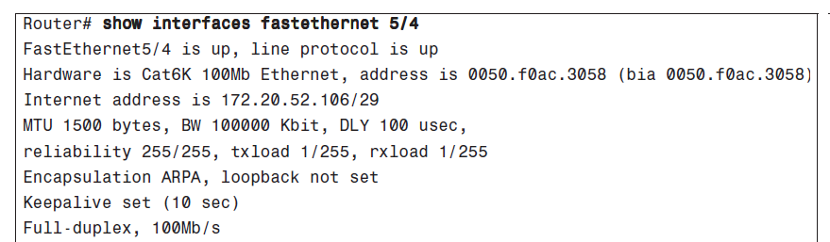
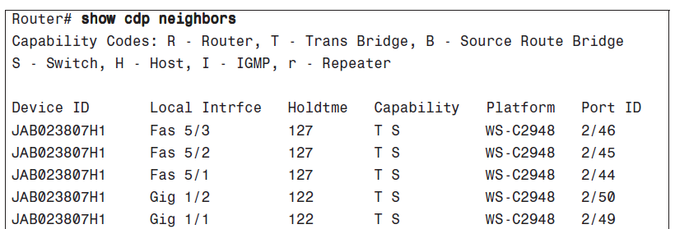
CLI Issues: Example

Slide 55
CLI Concluded
Very rich set of functionality
  Literally, thousands of commands
  Every new features extends the set
    New options/subcommand modes
Commands productive for human administrators
  Large user base, trained work force
Not well suited (and never intended) for management applications
  Retrieval and interpretation of management information has challenges
  No event reporting (CLI should join with other protocols)

Slide 56
Outline
Network Management Protocol
Communication Patterns
SNMP
CLI
syslog
Netconf
NetFlow/IPFIX

Slide 57
syslog
System messages written to a log
  Provide trail of device activity
    Each syslog message is an entry in that log
  Offline analysis of logs by system administrator
  Not specific to network devices (servers, …)
The “message” can be
  Error messages … system debug messages
The “log” can be
  A local file on filesystem
  A socket to send log messages directly to remote host

Slide 58
syslog (cont’d)
Used as general event mechanism
  Very comprehensive coverage of events
  Management applications as users
  Near-real time
Compare with CLI
  Easy instrumentation
  Comprehensive coverage
  Consumption intended for administrators
  Processed also by management applications
syslog usage
  Many syslog messages might never be of any practical use
  Under certain circumstances, the capability to retrace much of the device’s activity trail is invaluable
    Services degrading severely
    Suspected network break-ins

Slide 59
syslog Messages
Each message is a line in the log
  Header: Prefix of the line
  Body: Content of message
Header
  Minimal but essential information about the message
  Very structured manner: Time, Host, Severity, Subsystem, Sequence #, …
Body
  The informal content of message
    Even plain English text
However there is not one common standard header for all devices

Slide 60
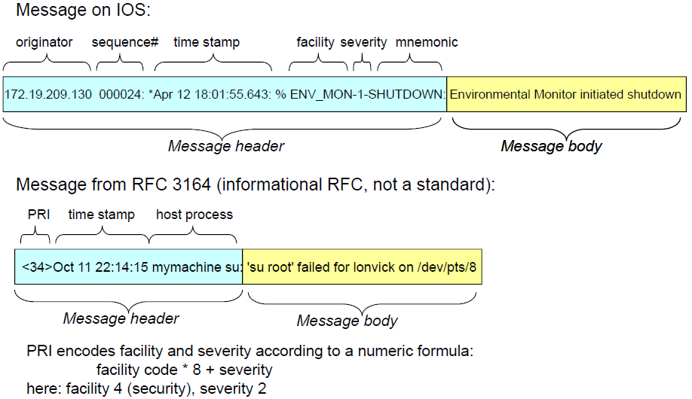
syslog Message Examples

Slide 61
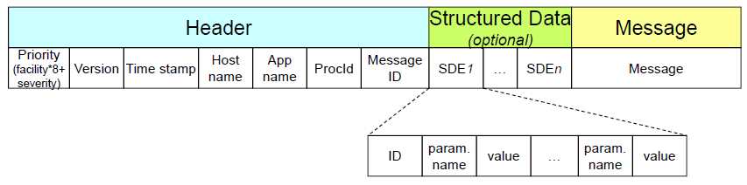
IETF syslog Protocol
Message text encoding can (but doesn’t have to) use UTF-8
The priority is a combination of a facility and a severity
  Facility * 8 + severity
Timestamps: RFC 3339
Application name + Process ID → Specify the log source

Slide 62
IETF syslog Protocol
Structured Data Element is new staff in IETF syslog
  ID
  Set of (name, value) tuples
Message part is the free format text

Slide 63
syslog Severities
Numerical code | Severity
0 | Emergency: system unusable
1 | Alert: e action must be taken immediately
2 | Critical: critical conditions
3 | Error: error conditions
4 | Warning: warning conditions
5 | Notice: normal but significant condition
6 | Informational: informational messages
7 | Debug: debug-level messages

Slide 64
syslog Facilities
Code | Facility
0 | Kernel Messages
1 | User-level Messages
2 | Mail System
3 | System Daemons
4 | Security Messages
5 | syslogd Messages
6 | Line Printer Subsystem
7 | Network Subsystem
8 | UUCP Subsystem
9 | Clock Daemon
10 | Security Messages
11 | FTP Daemon
12 | NTP Daemon
13 | Log Audit
14 | Log Alert
15 | Clock Daemon
16 -- 23 | Local (user defined)
Priority: facility*8+severity
Examples:
  191: debug of local7 (23*8+7)
  89: critical msg from FTP daemon
  30: informational msg from system daemon

Slide 65
syslog Deployment: Definitions
A machine that can generate a message will be called a "device"
A machine that can receive the message and forward it to another machine will be called a "relay"
A machine that receives the message and does not relay it to any other machines will be called a "collector"
  This has been known as a "syslog server"

Slide 66
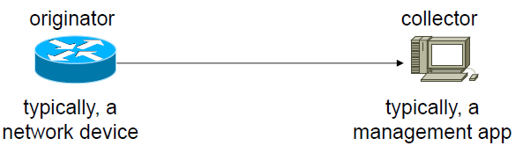
syslog Deployment Option 1

Slide 67
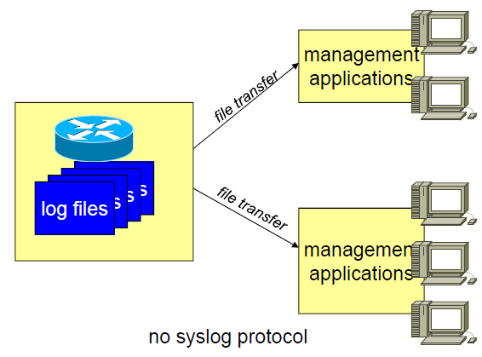
syslog Deployment Option 2

Slide 68
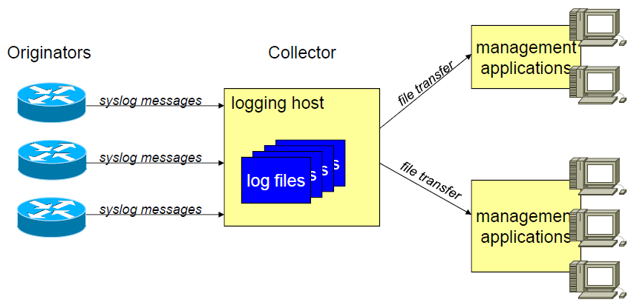
syslog Deployment Option 3

Slide 69
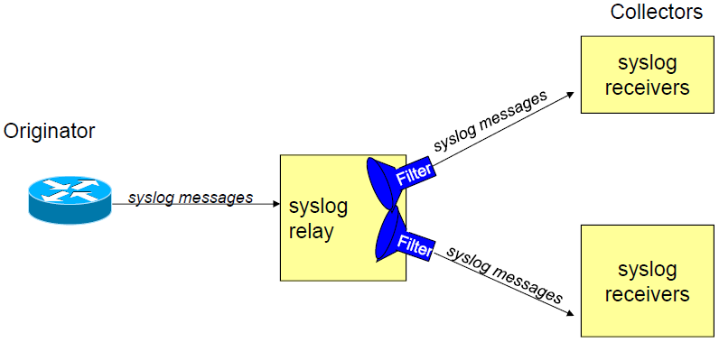
syslog Deployment Option 4
Example filters:
  Severity
  Facility
  Message ID
  Regular expression on message body

Slide 70
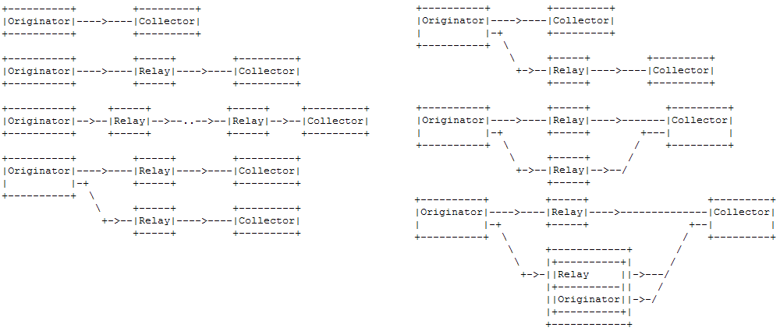
syslog Deployment Options: RFC 5424

Slide 71
syslog Deployment: Security & Reliability
Authentication: No authentication mechanism
    Misconfigured devices or attacker can send fake log
Integrity: No integrity mechanism
Confidentiality: Plain-text protocol
Sequenced delivery: No guarantee for ordered delivery
Reliable delivery: No acknowledgement
If these are major concerns
  syslog over TCP: RFC 6587
  syslog over TLS: RFC 5425

Slide 72
Outline
Network Management Protocol
Communication Patterns
SNMP
CLI
syslog
Netconf
NetFlow/IPFIX

Slide 73
Netconf
SNMP not well suited for configuration management
  Security concerns (real (v1, v2c) or perceived (v3))
  Non-task oriented data model or transaction support
CLI not well suited as programmatic interface
  Screen scraping
  Lack of transactionality
  Lack of programmatic return codes
As a result, room for a programmatic interface to address configuration management needs
Netconf

Slide 74
Netconf Positioning
For configuration management
  Manage configurations and sub-configurations
    edit, copy, transfer, retrieve, merge, delete, ..
  Might extend into other areas, but not yet!!
    Operational data
      Why limit retrieval function just to configuration data
    Events
      Events included to notify configuration changes
  Utilizes Web technologies
    Specifically, XML (but not Web services)

Slide 75
Netconf Status
Championed by 2 IETF working groups
  Netconf – Netconf itself
Netconf protocol a standard since early 2008, revised 2011
YANG (Netconf’s SMIv2) a standard since 2010
Netconf implementations by Cisco and Juniper
No commercial management applications yet
Still young - success yet to be determined – but increasing traction

Slide 76
Netconf Datastores
Document-oriented approach for device configuration
  Configuration can be considered as structured document
    Can be retrieved or manipulated
  A filtering mechanism to retrieve/modify a subset of configuration
Configuration information contained in datastore
  In essence, the Netconf MIB
  Hierarchical structure: datastore contains other datastores

Slide 77
Netconf Datastores (cont’d)
Multiple datastores can exist (think configuration files)
  <running>– like running config
  <startup> – like startup config
  <candidate> – a separate datastore to hold a configuration that could be applied at some other point in time
    Does not need to be supported
    Availability “negotiated” during connection establishment
In Netconf terminology, Managing the device means managing its datastore(s)
  Operations applied against datastores
  Subtree filtering: apply operation against a particular subset
    E.g. configuration of a card or subsystem

Slide 78
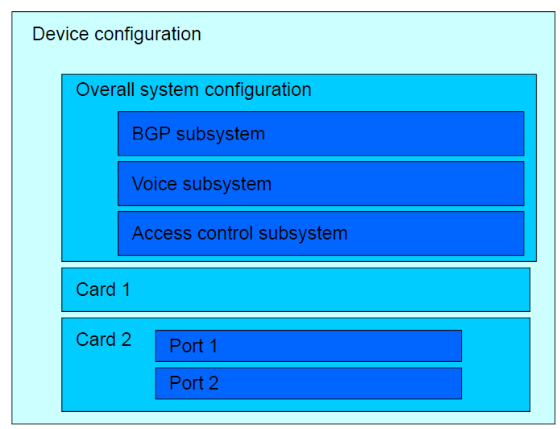
Hierarchical Datastore Concept

Slide 79
Netconf & XML
Every management operation (every request and every response) is encoded as an XML document
  The requested operation & response
  The operation parameters
Configuration information inside a datastore is itself encoded in XML
  datastore contains tags that divide the configuration information into different portions
  No predefined tags
Management information must be “XML-ized”
  Sophisticated XML document
  A set of XML tags to delimit a configuration file in its entirety
    Just a few XML tags for lot of CLI command

Slide 80
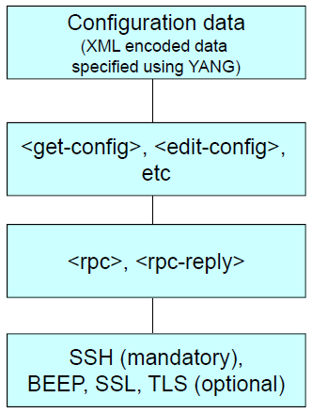
Netconf Architecture

Slide 81
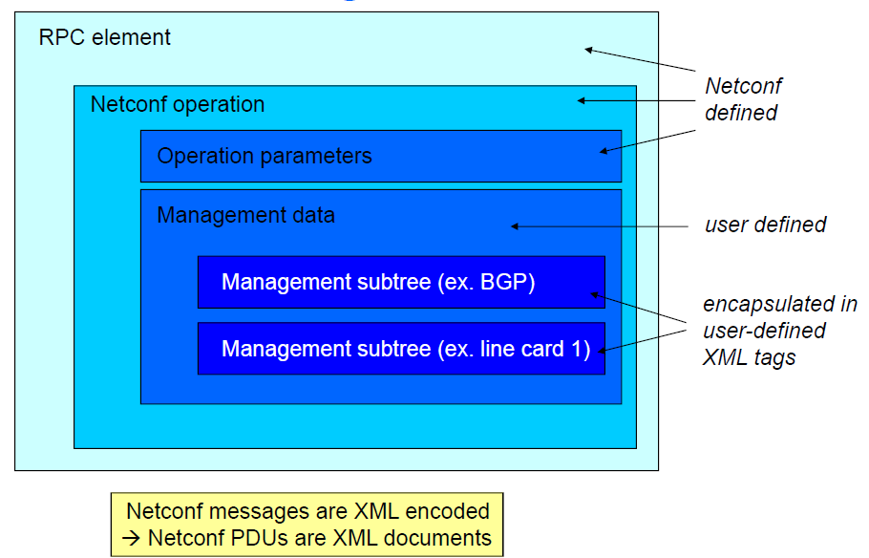
Netconf Message Structure

Slide 82
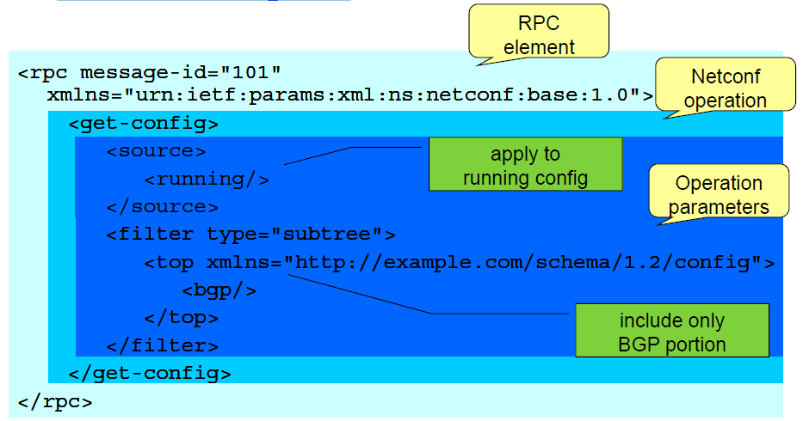
Netconf Request

Slide 83
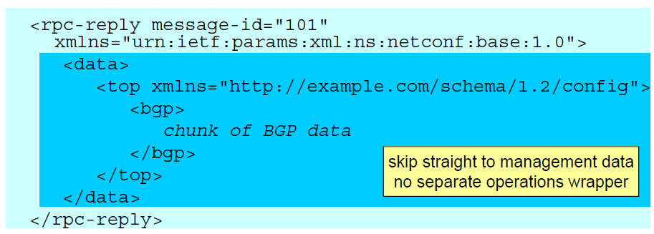
Netconf Reply

Slide 84
Netconf Operations
<edit-config>
  One of 4 operations:
    Merge (default)
    Replace (delete any existing configuration in datastore)
    Create (error if config/subtree exists already)
    Delete
  Target: which datastore
  Config: the configuration to be applied
  Optionally (not always supported, negotiated up-front):
    Test-option (validate before applying)
    Error-option (stop[default] / continue/ rollback on error)

Slide 85
Netconf Operations (cont’d)
<copy-config>
  Copy from a source to a target
  Target is overwritten or created
<delete-config>
  Cannot have <running> as target
<lock>, <unlock>
  Datastores only available as target as a whole
    Cannot just lock subtree
  Locks apply beyond scope of Netconf itself
    Cannot change contents of a datastore through other management interfaces either, e.g., CLI

Slide 86
Netconf Operations (contd.)
<get-config>
  source: which datastore
  filter: which portions/ subtree (e.g. specified using xpath)
<get>
  Like <get-config>, but can include operational data
  Why a separate operation?
    Generated very differently: file transfer vs memory dump
    Retrieving operational data can take a lot more time and resource

Slide 87
Netconf Operations (contd.)
<close-session>
  Graceful session termination
<kill-session>
  Abort session
Why a separate operation?
  Outstanding requests responded to, or not
  Locks released, or not
  Rollbacks of <edit-config> “in transit” performed, or not

Slide 88
Netconf Operations (contd.)
Session establishment
  A handshake of <hello> messages at beginning of each session
  Assign a session ID (by the server)
    Only used to close the session, or indicate certain errors
  Advertise special capabilities (capability exchange)
    e.g. support for rollback, validation, ….

Slide 89
Example: <edit-config>
<rpc message-id="101" xmlns="urn:ietf:params:xml:ns:netconf:base:1.0">
<edit-config>
<target>
<running/>
</target>
<error-option> rollback-on-error </error-option>
<config>
<top xmlns="http://example.com/schema/1.2/config">
<interface>
<name>Ethernet0/0</name>
<mtu>100000</mtu>
</interface>
</top>
</config>
</edit-config>
</rpc>
<rpc-reply message-id 101
xmlns="urn:ietf:params:xml:ns:netconf:base:1.0">
<ok/>
</rpc-reply>

Slide 90
Netconf Content
Netconf itself does not specify content, nor how content needs to be described; early days: Vendor-specific
  Mostly, tagged CLI
  CLI blob legal but arguably constitutes “abuse”
YANG – Yet Another Next-Generation
  Data-Definition Language for Netconf
  Analogous role as SMIv2 for SNMP
    More powerful and semantically richer
      Capabilities for reuse, definition of RPCs, support for containment, conditions, constraints
    No more OIDs
    Considerably more complex to author
  Data encoding as XML, not ASN.1 BER

Slide 91
Outline
Network Management Protocol
Communication Patterns
SNMP
CLI
syslog
Netconf
NetFlow/IPFIX

Slide 92
Netflow / IPFIX
Collect network usage data from routers
  Which type of traffic
  Between which sources and destinations
  At which time
Applications
  Traffic analysis and monitoring
  Usage-based billing
  More detailed questions
    Who are my top N talkers? Which percentageWhich protocols do they use? HTTP? FTP? SMTP? P2P? DOS attack detection, …
2 flavors:
  Netflow (in various versions): Cisco-invented, “industry standard”
  IPFIX (IP Flow Information eXport): IETF standard

Slide 93
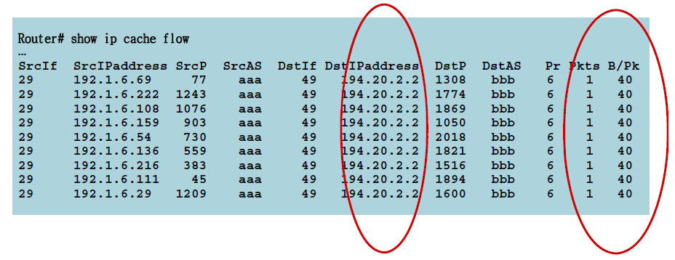
Applications for Netflow Example: Security Management
Typical DoS attacks have the same (similar) entries:
  Input interface, destination IP, 1 packet per flow, constant bytes per packet (B/Pk)

Slide 94
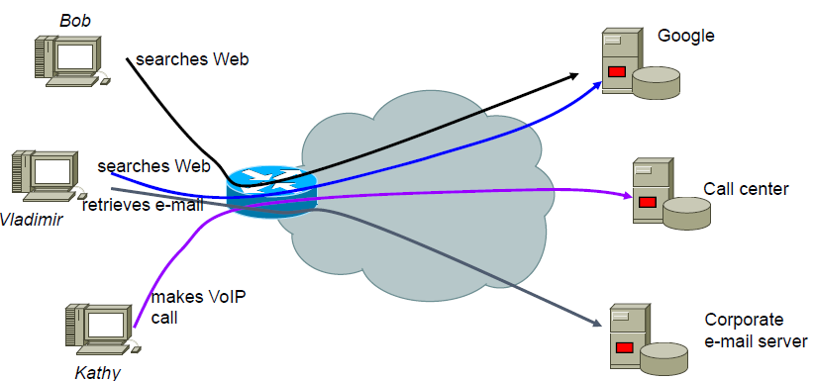
Concept of a Flow
When a packet goes from one direction in a certain other direction, chances are it’s not the only one
A “flow” is a stream of packets that are likely part of the same association, i.e. that share the same flow key

Slide 95
Challenges
How to identify flows
  IP is connection less protocol
  Network address are translated
How to detect start and end of flows
  No connection establishment / tear down in IP
So many flows in the network
  Large volumes of information need to be collected, processed, and transferred

Slide 96
History
Netflow cache first introduced to improve routing performance
  Cache routing decisions
  More efficient than route lookup for each packet
Relevance of cache contents for management not recognized until later
  Export of cache contents led to definition of Netflow protocol
Important Netflow versions
  v1: Original Netflow
  v5: Most deployed today, includes BGP information
  v8: Aggregation capability
  v9: Customization of exported data
  IPFIX: IETF-standardized version based on v9

Slide 97
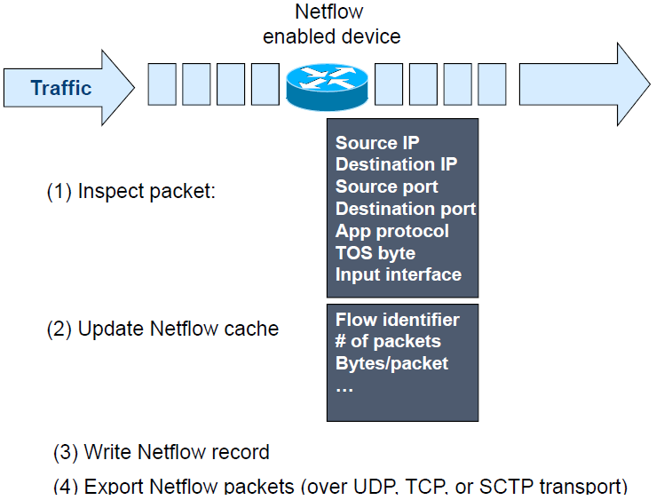
Netflow Concept

Slide 98
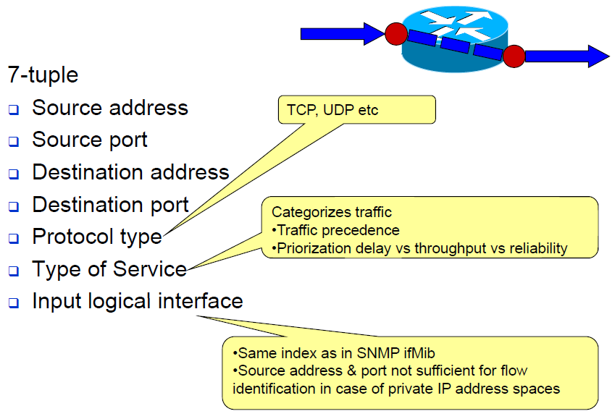
Challenge 1: Flow Identification

Slide 99
Challenge 2: Flow Demarcations
When does a flow start
  First unique packet that hasn’t been seen before / not in the cache
When does a flow end?
  No traffic observed for a certain time interval
    E.g.,15 seconds
  Application-protocol level indicates flow has completed
    e.g., TCP FIN or RST
  Flow has long duration (e.g. 30 minutes)
    Otherwise might have huge flows and not know about it

Slide 100
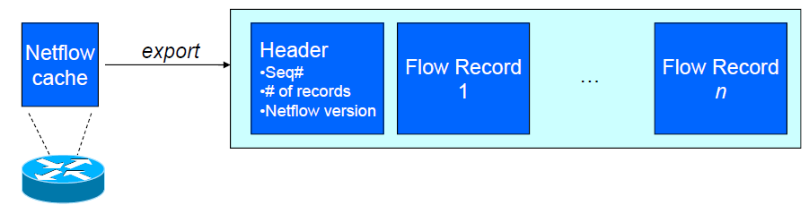
Netflow Export Format (version 5)
Header
  Sequence # of packet
  # of flow records in this packet
  Version # of Netflow
Each record
  Flow keys
  Statistical information

Slide 101
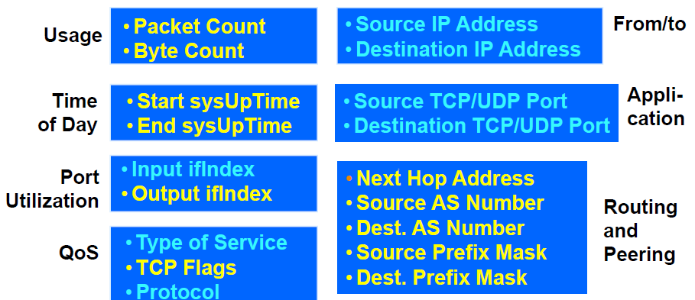
Version 5 Flow Content

Slide 102
Evolving Netflow: Sampled Netflow (RFC 5476)
CPU utilization in high-speed links
Approach: choose only a sampling of packets
  Fixed sample intervals
    Inaccuracies in case of fixed traffic patterns
  Random sample intervals
    Statistically more accurate
Some inaccuracies:
  Misses small flows
  Tends to underestimate flow duration

Slide 103
Evolving Netflow: Extending & Customizing
Extensibility
  Allow to specify new information fields to export
    Examples: VLAN information, wireless parameters, …
  Need to separate Netflow protocol from information
Customization of fields to export
  Specify templates to indicate the required subset
Defining new / different keys
  Custom definition of a “flow”
Addressed in Netflow v9 and IPFIX

Slide 104
IPFIX
IP Flow Information eXport
  IETF standard, built on Netflow v9
Distinguish between templates and data records
  Templates define structure and interpretation of fields in data records
  Data records carry the actual data
    Refer to previously transported template records (using the template number)
Option templates provide a mechanism for exporter for additional information such as sampling parameters, or statistics such as the number of packets processed, or …

Slide 105
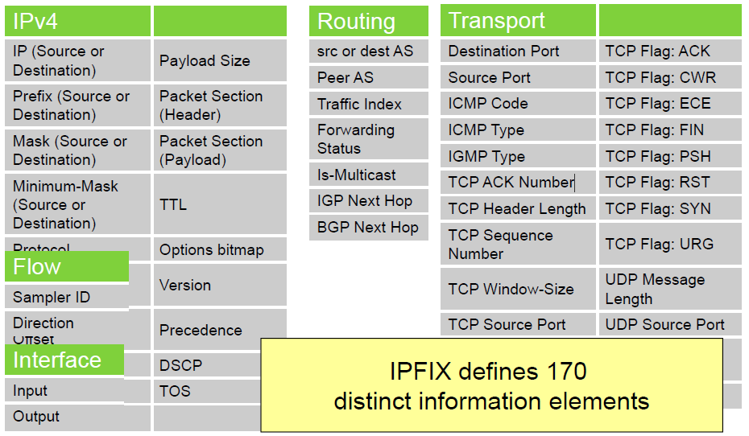
Flexible Flow Record: Key Information Elements

Slide 106
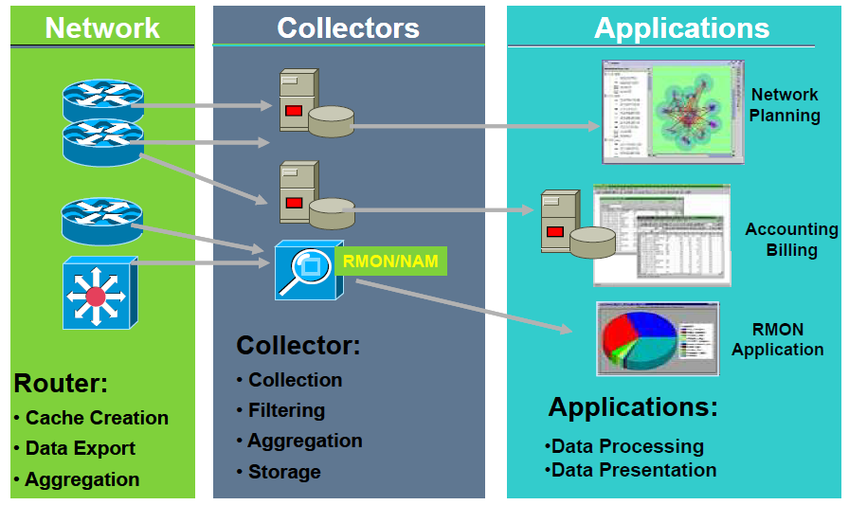
NetFlow Deployment

Slide 107
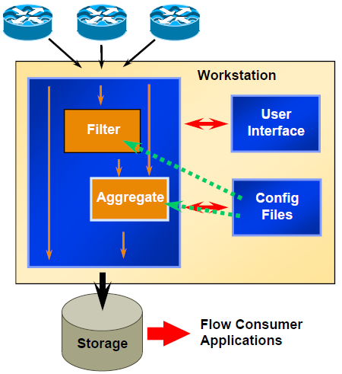
Example Collector Application
Flow record reception
Data volume reduction
  Filtering, Aggregation
File storage
  Flat or binary and compression in 3.0
Different form factors
  Appliances – easer to deploy
  SW apps

Slide 108
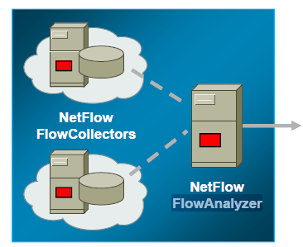
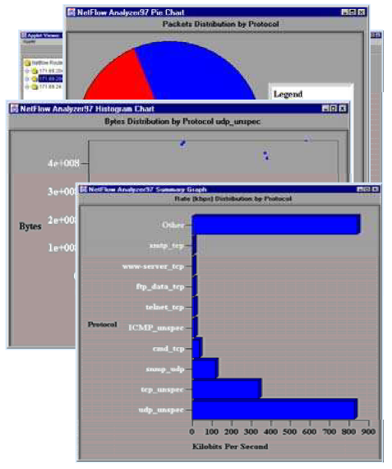
Network Data Analyzer
Graphical display of NetFlow data
Consumes from NetFlow FlowCollector(s)
Time-based analysis ands data sorting
Configure routers and FlowCollectors
Histograms, bar charts, and pie charts
Spreadsheet data export

Slide 109
Outline
Network Management Protocol
Communication Patterns
SNMP
CLI
syslog
Netconf
NetFlow/IPFIX

Slide 110
Summary
Important issues in NM protocols
  1) The communication protocol
    Packets/Messages
      Header, Message body, Primitive operations, Data encoding, …
  2) Information model
    MIB & its description language
  3) Transport protocol
Successful design choices
  Separate information model from communication protocol
    Standardize communication protocol & Information modeling language
    Allow vendors to define/develop own management parameters
  User pre-existing transport protocols

Slide 111
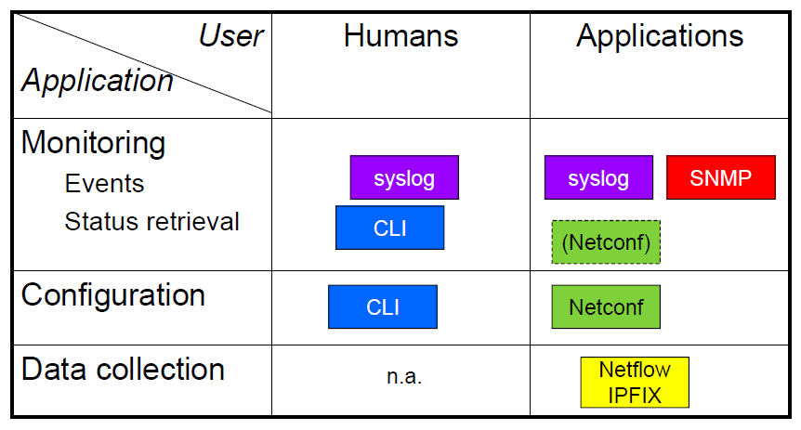
Summary

Slide 112
Other (Network) Management Protocols
CORBA
  Agent is a remote object
  Manager calls/invoke the methods of the objects
WBEM (Web Based Enterprise Management)
  Standard by DMTF (Distributed Management Task Force)
  Management information are described by CIM which are encoded by XML and transported over HTTP
WSDM (Web Services Distributed Management)
  Similar to CORBA; but uses XML and HTTP for method invocation

Slide 113
Other IETF NM Protocols (RFC 6632)
DHCP: LAN IP address management
IPv6 network operation and transition RFCs
Policy based management: RFC2753 & RFC3460
IP Performance Metrics (IPPM)
Remote Authentication Dial-In User Service (RADIUS)
Diameter AAA Protocol (Diameter)
Control and Provisioning of Wireless Access Points (CAPWAP)
Access Node Control Protocol (ANCP)
…

Slide 114
References
  Reading Assignment: Chapters 7 and 8 of “Alexander Clemm, ‘Network Management Fundamentals’, Cisco Press, 2007”
  Alexander Clemm, “Network Management”, Santa Clara University, http://www.engr.scu.edu/~aclemm
  Woraphon Lilakiatsakun, “Network Management”, Mahanakorn University of Technology, http://www.msit2005.mut.ac.th/msit_media/1_2553/ITEC4611/Lecture/

